Slide 1
Benchmarking of Quantum Algorithms on IBM Qiskit and Google Cirq
A presentation by CDAC, Hyderabad

Slide 2
References:
To perform this benchmarking we have used “Application-Oriented Performance Benchmarks for Quantum Computing” Suite developed by Quantum Economic Development Consortium (QED-C) collaboration.
Reference Papers:The QED-C committee that developed these benchmarks released (Oct 2021) a pre-print of a paper describing the theory and methodology supporting this work at [2110.03137] Application-Oriented Performance Benchmarks for Quantum Computing (arxiv.org)
GitHub link for the Suite: SRI-International/QC-App-Oriented-Benchmarks: QED-C: The Quantum Economic Development Consortium provides these computer programs and software for use in the fields of quantum science and engineering. (github.com)

Slide 3
What are quantum application-oriented performance benchmarks?
Quantum application-oriented performance benchmarks are tests designed to evaluate the effectiveness of quantum computers for specific tasks.
They include benchmarks for quantum algorithms (e.g., Shor's algorithm), machine learning, optimization, quantum chemistry, cryptography, error mitigation, scalability, and hybrid quantum-classical computing.
These benchmarks help assess the practical utility and efficiency of quantum computers in real-world applications.
Quantum benchmarks assess the performance of quantum computers for specific tasks.
The one we are considering now is “Algorithm Specific Benchmarks” to assess quantum algorithms for tasks like factoring and searching.

Slide 4
Why Benchmarking is required for Quantum Computers?
The information processing capabilities of Quantum Computers are mainly limited by errors occurred.
Many of these errors are caused due to noise or miscalibrations of lowest level components in the system.
But many users seeking to run an application on a quantum computer are not concerned with low-level details, but rather how likely their application is to execute successfully.
Extrapolating low-level performance metrics to predict the performance of a specific application is challenging, and these extrapolations are often inaccurate.
The limited predictive power of low-level performance metrics has contributed to an increasing focus on benchmarks that concisely and directly summarize the holistic performance of a quantum computer.
One of the best example we can consider is “Quantum Volume Benchmarking”.

Slide 5
Why Benchmarking is required for Quantum Computers? (contd.)
Volume Benchmark is designed to probe the effective useful size of a specific quantum computer and summarize it in one number: the quantum volume.
The quantum volume has been widely adopted and reported by the community. However, due to the complexity of errors in quantum hardware, neither a device’s quantum volume nor any other single metric is likely to accurately predict its performance on all applications.
There is a need for a diverse set of application-centric metrics and benchmarks that test the performance of quantum computers on practically relevant tasks.
Such benchmarks will enable hardware developers to quantify their progress in commercially relevant ways, and will make it possible for end users to more accurately predict how the available hardware will perform on their application

Slide 6
Benchmarking Suite:
It is an extensible suite of quantum performance benchmarks that are application-oriented.
The benchmark suite is intended to evaluate the capability of quantum hardware to successfully execute meaningful computational tasks, and to reflect likely use cases for quantum computers.
The benchmarking suite is available as a public, open-source repository with extensive documentation.
This benchmarking suite consists of a set of benchmarks that are each based on an algorithm or application, and each benchmark is designed to measure proxies for the quality of and the time to solution for its corresponding application.

Slide 7
How benchmarking are made using the Suite?
To analyze the results of benchmarks, the application suite adopts the framework of volumetric benchmarking.
This approach, generalizes the Quantum volume, displays the resulting quality of each application as a function of circuit width (often equal to problem size) and computational length (circuit depth).
Here normalized measure of resulting quality is calculated which can be comparable with various applications.
Normalized and device-independent measure of circuit depth are defined that removes many complications associated with device gates and connectivity.
This analysis makes it possible to easily compare the performance of different quantum computing devices on the same tasks.

Slide 8
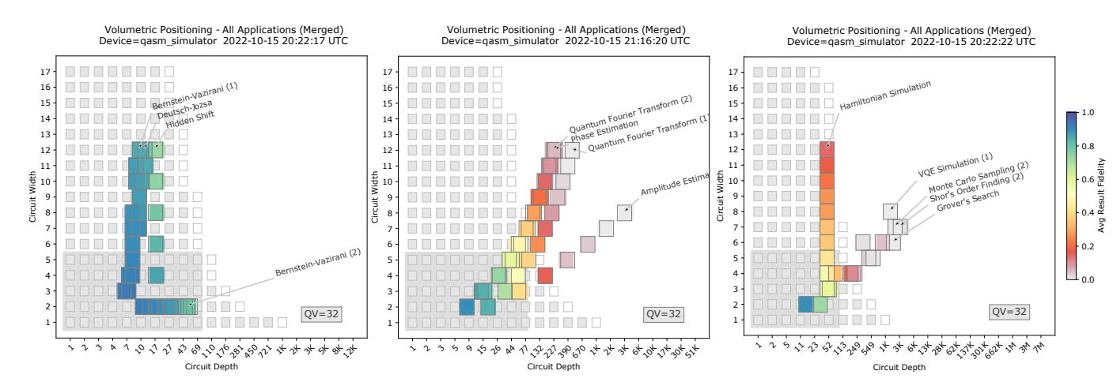
Understanding the Benchmarking Plots:

Slide 9
Understanding the benchmarking Plots (contd.):
These three plots are the results of executing the suite on a simulator of a noisy quantum computer, whose results are split into benchmarks of 3 categories of algorithms: 1.tutorial, 2. subroutine, 3. functional.
For each benchmark, circuits are made to run on different problem sizes i.e., on different circuit widths.
Circuit width is the number of Qubits the circuit acts on which are typically (2 to 12 Qubits).
The result we get here is fidelity which is the measure of the Quality of responses given by the Quantum Computer.
This fidelity is computed for each circuit execution and is represented as coloured square positioned at the corresponding circuit’s width and normalized depth.

Slide 10
Understanding the benchmarking Plots (contd.):
In quantum computing, circuit depth refers to the number of sequential computational steps or time-steps required for the execution of a quantum circuit. It measures how "deep" or layered a quantum circuit is concerning the number of quantum gates or operations it contains.
Each gate in a quantum circuit typically takes a certain amount of time to execute physically. The circuit depth correlates with the time required for the quantum computation to occur, although the relation is not always direct due to various factors like gate implementation, error correction, etc.
Results for circuits of equal width and similar depth are averaged together.
The results of the application-oriented benchmarks are shown on top of a ‘volumetric background’ (grey-scale squares).

Slide 11
Component-Level Performance metrics:
Component-level benchmarks and characterization protocols, such as randomized benchmarking or gate set tomography, can provide insight into the type and magnitude of the errors in Quantum Computing Information. These tools are critical for experimental efforts to improve hardware.
There are many techniques for estimating component-level performance of quantum computing devices including randomized benchmarking and gate set tomography used by hardware provides for calibration and testing.
The measure of performance that providers report to users of their systems typically include one- and two-qubit gate fidelity, state preparation and measurement (SPAM) fidelity, and measures of how long each qubit can retain quantum information (T1 and T2 coherence times).

Slide 12
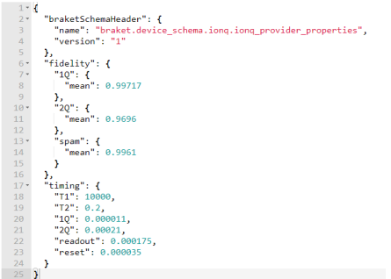
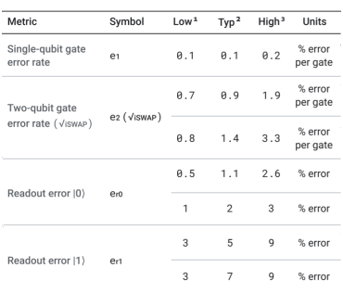
An example of component-level performance metrics provided by Amazon Braket for the IonQ Quantum Processing Unit
An example of component-level performance metrics provided by Google for its Weber device (Sycamore class)

Slide 13
Limitations of component level performance metrics:
Component-level performance metrics provide a lot of information about a machine, but they have at least two important limitations.
Firstly, component-level performance metrics are typically not sufficient to accurately predict a device’s performance on an algorithm.
This is because summary metrics cannot capture the full complexity of errors in quantum computing components (e.g., individual gates and readouts), and not all sources of error are even apparent when testing a single component.
Second, component-level metrics are challenging for non-specialists to interpret. It is often difficult for a prospective quantum computer user to extrapolate from component-level metrics to predict how their application will perform.

Slide 14
Quantum Volume
Here we are comparing the benchmarks with predictions extrapolated from device’s Quantum volume.
IBM has introduces Quantum Volume metric to quantify and compare the capabilities of Quantum Computing devices.
Multiple factors of Quantum computers like, number of Qubits, Systemic errors, device connectivity, compiler issues, etc. which contributes to overall performance of Quantum Computer, have an influence over Quantum volume.
A quantum computer’s quantum volume is defined in terms of its average performance on a particular set of random circuits, which we refer to as the quantum volume circuits.

Slide 15
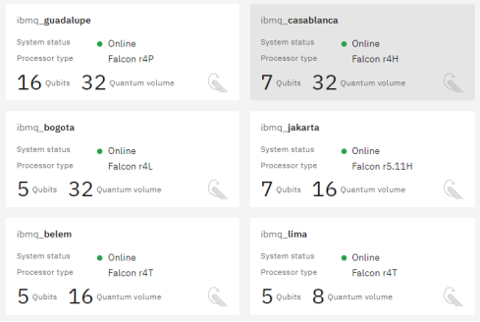
Quantum volume example: The number of qubits and the quantum volume for a selection of IBM Q machines, accessed via IBM Quantum Services.
IBM publishes the quantum volume for each machine that it makes available to external users through IBM Quantum Services
Note: A device with more qubits does not always have a larger quantum volume.

Slide 16
Quantum Volume: (contd.)
A device’s quantum volume is defined to be with n being both the width (the number of qubits) and the depth (the number of layers) of the largest quantum volume circuits that can be executed ‘successfully’ on a specified quantum device.
For example if a Quantum Computer successfully execute 5 layered Circuit with 5 Qubits but unable to do the same with 6 layered Circuit and 6 Qubits then, Quantum volume = = 32.
Quantum volume is not guaranteed to reliably predict the performance of wide and shallow circuits, or deep and narrow circuits, as it is being simulated by Classical Computers where it fails to summarize many dimensions of Quantum States.

Slide 17
Volumetric Benchmarking:
Volumetric benchmarking is a framework for constructing and visualizing the results of large, flexible families of benchmarks.
It is done in 3 steps:
Choosing a family of circuits to use as a benchmark.
Selection of circuits from that family and executing on the required hardware.
Plotting the observed performance of the hardware on these circuits as a function of the circuit’s width and depth (volumetric space).

Slide 18
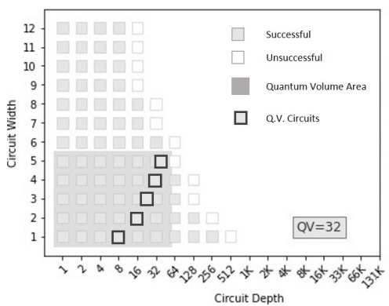
Example of Volumetric Benchmarking:
The data points (or grey-scale squares) represent result quality for tested circuits of that shape (width x height).
It takes only two values Success (grey) and fail (white).
Grey rectangle is Quantum Volume Region.
Black Squares with grey in them represent location of Quantum Volume Circuits.
Volumetric benchmarking can be used to estimate and report the performance of both wide shallow circuits and narrow deep circuits.
This Benchmarking is not restricted to a single kind of circuit(e.g., the specific random circuits of the quantum volume benchmark) which makes it ideal ones.

Slide 19
Procedure of Benchmarking:
This Benchmarking suite consists of four components:
A set of algorithms or subroutines {A} [e.g., Grover’s Search or the Quantum Fourier Transform (QFT)], each with a variable input size n.
For each algorithm A, one or more recipes for turning that algorithm into a set of quantum circuits for each input problem size n. These circuits are always closely related to, but not necessarily identical to, the circuits that define the algorithm. Note that these circuits are specified using a hardware-agnostic gate set, and they therefore must be compiled into a specific device’s native operations before they are run.
A procedure for using a given family of circuits as a benchmark, including a method for selecting circuits from to run (such as sampling from a distribution over ) and, e.g., a method for varying n.
Methods for analyzing the data.

Slide 20
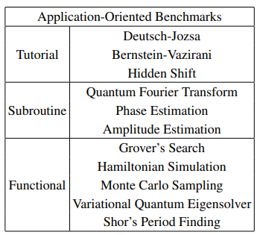
The Algorithms in the Benchmarking Suite:
Table I : The initial set of quantum algorithms and applications included within our application-oriented benchmarking suite.

Slide 21
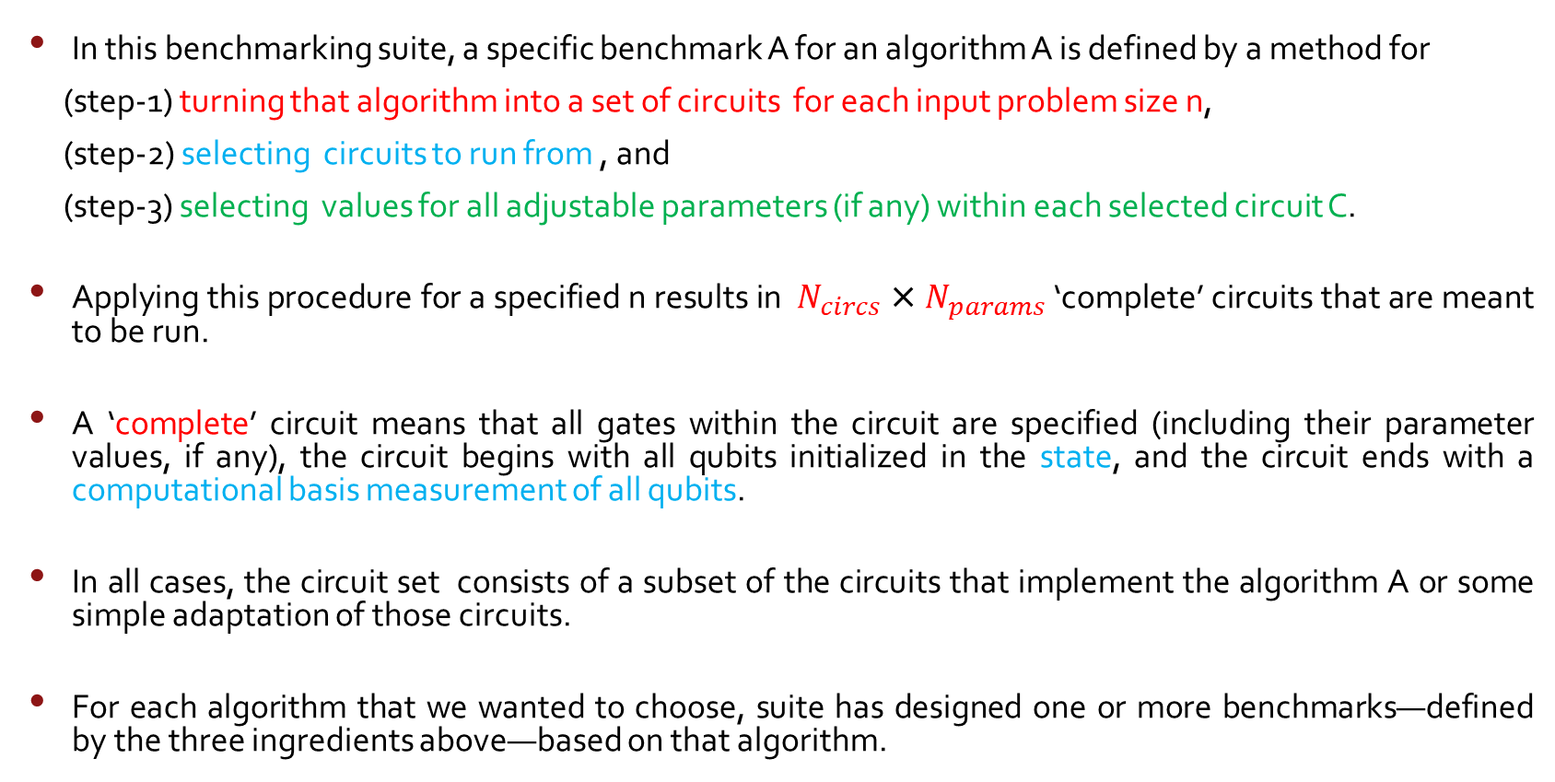
Construction of Benchmarking Circuits:
In this benchmarking suite, a specific benchmark A for an algorithm A is defined by a method for
(step-1) turning that algorithm into a set of circuits for each input problem size n,
(step-2) selecting circuits to run from , and
(step-3) selecting values for all adjustable parameters (if any) within each selected circuit C.
Applying this procedure for a specified n results in $N_{circs}$ × $N_{params}$ ‘complete’ circuits that are meant to be run.
A ‘complete’ circuit means that all gates within the circuit are specified (including their parameter values, if any), the circuit begins with all qubits initialized in the state, and the circuit ends with a computational basis measurement of all qubits.
In all cases, the circuit set consists of a subset of the circuits that implement the algorithm A or some simple adaptation of those circuits.
For each algorithm that we wanted to choose, suite has designed one or more benchmarks—defined by the three ingredients above—based on that algorithm.

Slide 22
Essential Criteria to be followed for construction of Benchmarking Circuits:
It should be feasible to run and analyze the data produced by a benchmark.
Quantum computer’s performance on a benchmark A built from an algorithm A should reflect that computer’s performance on A as closely as possible.
Satisfying both criteria is challenging, as they are conflicting. This is because the quantum circuits of a useful quantum algorithm applied to a classically intractable problem instance cannot be efficiently simulated on a classical computer, so we cannot simply compare the output of these circuits to the results of a classical simulation.

Slide 23
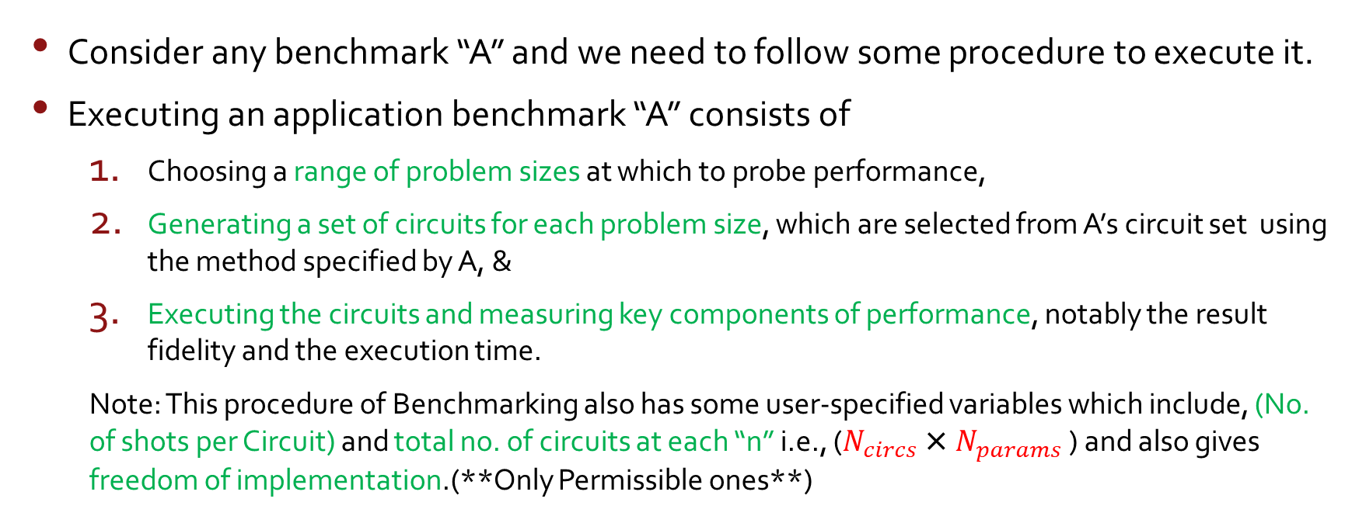
Benchmarking Procedure:
Consider any benchmark “A” and we need to follow some procedure to execute it.
Executing an application benchmark “A” consists of
Choosing a range of problem sizes at which to probe performance,
Generating a set of circuits for each problem size, which are selected from A’s circuit set using the method specified by A, &
Executing the circuits and measuring key components of performance, notably the result fidelity and the execution time.
Note: This procedure of Benchmarking also has some user-specified variables which include, (No. of shots per Circuit) and total no. of circuits at each “n” i.e., ($N_{circs}$ × $N_{params}$ ) and also gives freedom of implementation.(**Only Permissible ones**)

Slide 24
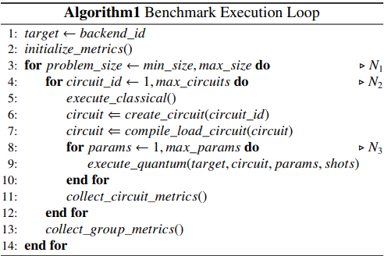
Example: Algorithm-1 for Benchmark Execution
In all benchmarks in suite, the classical routines consist
solely of circuit construction and compilation.
Loop represents the complete range of problem sizes.
Loop represents multiple interleaved executions of classical and Quantum Execution routines.
In this step each of the benchmark’s circuits is compiled into the native operations of the hardware under test, using the provider’s compilers so that testing of performances of both provider’s classical compilation algorithms and the quantum hardware are performed.
Each iteration of the loop constructs a quantum circuit, which can be a parameterized circuit.
Loop executes this parameterized circuit with certain range of parameter values.

Slide 25
Volumetric Positioning:
Every application-oriented benchmark is associated with a family of circuits that is parameterized by the input problem size, i.e., each input size “n” defines a circuit ensemble .
Each circuit family has a footprint that represents the way in which the shape of the circuits—i.e., their width and depth—varies as a function of the input size. So performance of benchmarks can be reported in “ Width x depth = Volumetric Space”.
For each application benchmark A, fixed input size n always corresponds to a single circuit width w. Note: that often w = n, i.e., a problem instance of size w uses an n-qubit circuit, but this is not always the case. Ex: Bernstein-Vazirani uses n=2 qubit circuits for any input problem size “w”.
In contrast, a benchmark A’s circuits can have a range of depths for each input size.
For example, the algorithms in the ‘tutorial’ category use a varied-depth oracle circuit that encodes the problem instance. We therefore use the circuits’ mean depth to define that ensemble’s volumetric position, and we report average performance over the circuit ensemble.

Slide 26
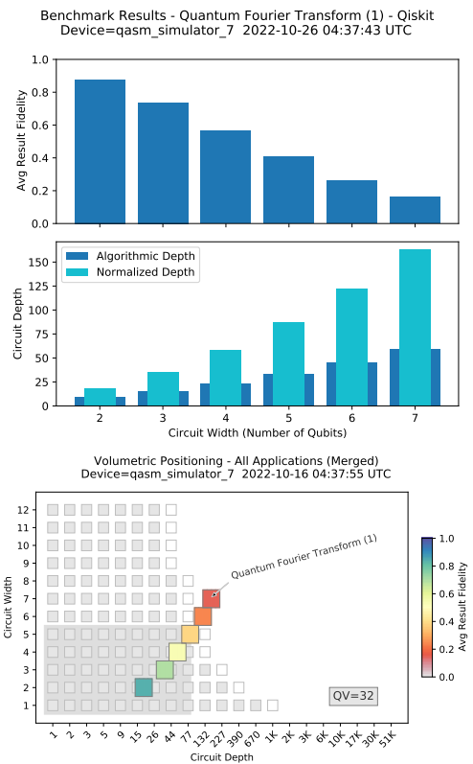
Volumetric Positioning: (Contd.)
Each benchmark consists of running its circuits for a range of problem sizes, which closely correspond to the circuits’ widths.
Each data point (small rectangles) summarizes the results for the circuits of a particular problem size.
The rectangle’s location indicates the circuits’ width and average depth,
The color indicates the average quality of the result for that circuit shape.
We quantify the quality of the result using the average result fidelity.
The width and depth of benchmarking circuits for different applications can be similar, resulting in overlap on the volumetric plots. Whenever this is the case the result fidelities from the overlapping circuits for different applications are averaged together.

Slide 27
Volumetric Backgrounds:
Algorithmic benchmarks directly probe a quantum computer’s performance on application-like tasks, but performance on these tasks can also be predicted from a processor’s known performance data. (Ex: Randomized benchmarking error rates -> a measure of the average error rates of quantum computing hardware platforms.)
Discrepancies between these predictions and experimental results can reveal the presence and size of interesting and important physical effects, e.g., crosstalk.
A volumetric background means a prediction for the result fidelity, as a function of circuit width and depth, obtained from some method that is independent of our application oriented benchmarks.
This Volumetric backgrounds are extrapolated from corresponding device’s Quantum Volume.

Slide 28
Volumetric Backgrounds:
A width w and depth d circuit is predicted to have a result fidelity above if w*d < where is the quantum volume.
This means, a circuit is predicted to succeed if its depth × width is no larger than the largest successful quantum volume circuits.
Quantum volume region encompasses all circuit shapes that are smaller than the largest successful quantum volume circuit, and so circuits within this region will have high result fidelity under weaker assumptions which means that these circuits are expected to maintain high accuracy or fidelity in their outputs even when certain conditions or parameters are not as rigorously controlled or optimized.

Slide 29
Circuit Depth:
A circuit’s depth is the number of layers of logic gates it contains. However, any specific quantum computation can be implemented with many different circuits, perhaps defined over different gate sets, that have different depths.
This suite contains high-level gates which use algorithm-specific gate sets which might not be implementable on many devices.
So we need to transpile high-level circuits into set of primitive quantum gates that are suitable for Hardware.
The depth of this transpiled circuit is called “ Physical Depth” which is often greater than the depth of actual high-level circuit.
For example, Toffoli gates (multiply-controlled NOT gates) are often used in high-level descriptions of algorithms, but each Toffoli gate must be decomposed into many one- and two-qubit gates in order to run it on most quantum hardware.

Slide 30
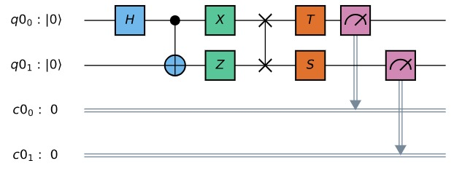

Slide 31
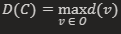
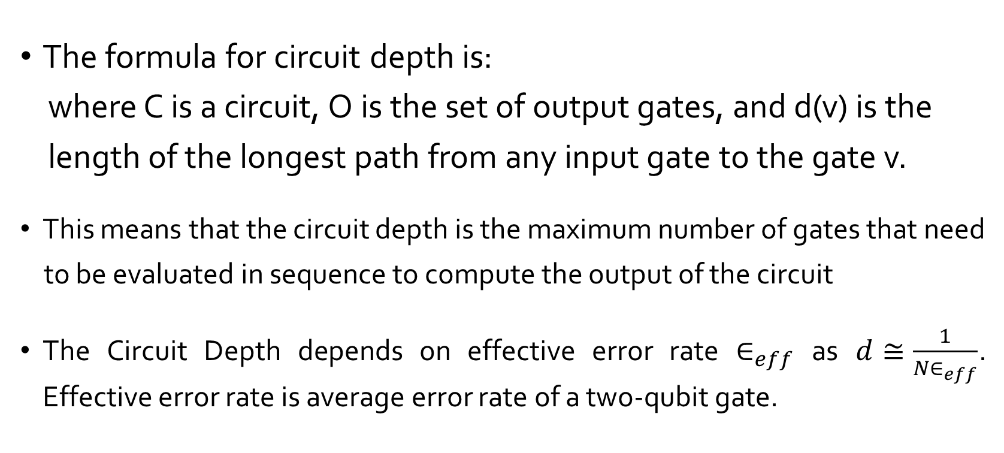
Circuit Depth: (contd.)
The formula for circuit depth is:
where C is a circuit, O is the set of output gates, and d(v) is the
length of the longest path from any input gate to the gate v.
This means that the circuit depth is the maximum number of gates that need
to be evaluated in sequence to compute the output of the circuit
The Circuit Depth depends on effective error rate $∈_{eff}$ as $d≅\frac{1}{N∈_{eff}}$. Effective error rate is average error rate of a two-qubit gate.

Slide 32
Types of Depth:
Algorithmic depth: For each algorithm, express its circuits in a canonical form using a natural, algorithm-specific gate set. The depth of these canonical circuits is what we call algorithmic depth. For example, Grover’s Search algorithm consists of repeating two subroutines (diffusion and oracle subroutines) which could be considered the natural gate set for Grover’s algorithm.
Normalized depth: Choose a basis (gate set) and a canonical programmability constraints—e.g., some set of one and two-qubit gates with all-to-all connectivity—and some classical compilation algorithm for transpiling a circuit into this gate set. Normalized depth is computed by transpiling a high-level circuit into this canonical gate set, and computing that transpiled circuit’s depth.
Physical depth: Transpile a high-level circuit into a processor’s native operations. The depth of this ‘low-level’ circuit defines the physical depth.

Slide 33
Drawbacks of Physical and Algorithmic Depths:
All these three definitions for depth have complementary strengths and weaknesses.
If we consider algorithmic depth as the circuit depth, it connects the depth with computationally-relevant quantities.( Ex: no. of queries to a oracle in Grovers Algorithm). But this kind of approach makes it difficult to compare results for other algorithms.
If we consider Physical depth - enables transparent comparison between the results of various algorithmic benchmarks on the same processor (we expect circuits with similar physical depths to have similar result fidelities). However, a particular benchmark circuit’s physical depth varies across devices (because, e.g., it depends on a device’s connectivity) making cross-device comparisons challenging.
And it is also not made available by the providers and is not consistently defined because of the ambiguities are present in processor’s native operation.

Slide 34
Normalized Depth:
This is a device- and algorithm-independent definition for depth, obtained by specifying a device-independent basis (a gate set) to which the circuit is transpiled.
The middle plot of (Slide 26) shows an example of the depth of circuits from the QFT benchmark when
written in a high-level API (this is ‘algorithmic depth’) and
after the circuits have been transpiled to our standard basis, i.e., the normalized depth of the circuit.
In this example, and in most of the benchmarks, the normalized depth is larger than the circuit depth when written in a high-level API.

Slide 35
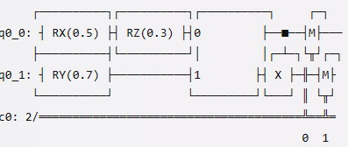
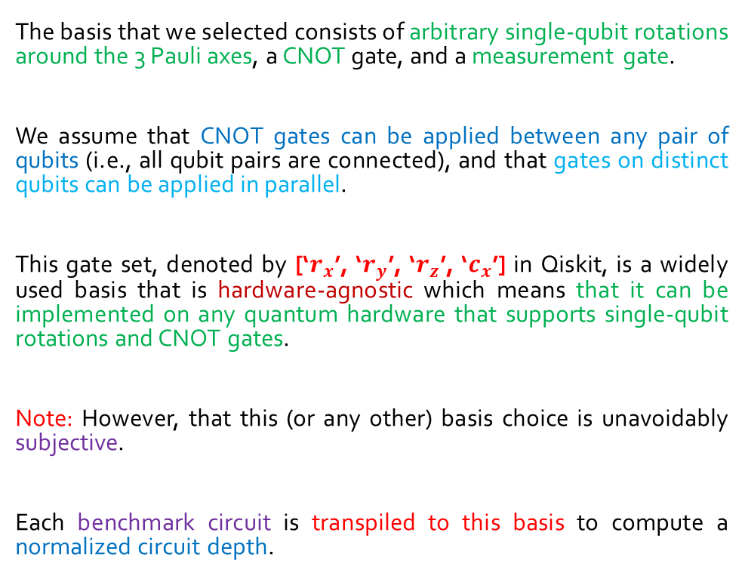
Normalized Depth: (Contd.)
The basis that we selected consists of arbitrary single-qubit rotations around the 3 Pauli axes, a CNOT gate, and a measurement gate.
We assume that CNOT gates can be applied between any pair of qubits (i.e., all qubit pairs are connected), and that gates on distinct qubits can be applied in parallel.
This gate set, denoted by [‘$r_{x}$’, ‘$r_{y}$’, ‘$r_{z}$’, ‘$c_{x}$’] in Qiskit, is a widely used basis that is hardware-agnostic which means that it can be implemented on any quantum hardware that supports single-qubit rotations and CNOT gates.
Note: However, that this (or any other) basis choice is unavoidably subjective.
Each benchmark circuit is transpiled to this basis to compute a normalized circuit depth.

Slide 36
Why Transpilation?
Transpiling is a process of converting source code from one programming language to another, usually with a similar level of abstraction. Transpiling is also known as source-to-source compilation or transcompilation.
However, finding the most efficient or minimal-depth compilation for a quantum algorithm is often a computationally complex problem. This complexity arises from the fact that determining the optimal sequence of gates, given a specific gate set, can be a kin to solving difficult mathematical problems.
The classical computational complexity implies that solving this problem using classical computers would take an impractical amount of time, especially as the size of the quantum circuit grows.
Due to these complexities, quantum computing frameworks like Qiskit use heuristic classical algorithms to transpile or compile quantum circuits. Heuristic algorithms are rule-based or approximate methods that aim to find reasonably good solutions but not necessarily the best or most optimal ones.
Hence, the normalized depth (the depth relative to some standard or benchmark) of the resulting compiled quantum circuit can depend on the specific heuristic algorithm used by the transpiler. Different algorithms may produce different depths for the same circuit, as they make different trade-offs in optimizing the circuit.
This is an undesirable property of normalized definitions for depth.

Slide 37
What about discrepancies in Qubit Connectivity on Actual Hardware?
When a quantum circuit designed in a quantum programming framework (like Qiskit, for instance) is executed on actual quantum hardware, it needs to be adapted to the specific characteristics and constraints of that hardware.
Quantum computers have physical layouts of qubits, and each qubit might not be directly connected to every other qubit due to limitations in physical connections (also known as connectivity constraints). This arrangement forms a topology or connectivity map.
Therefore, when the quantum circuit is executed on such hardware, the circuit needs to be transformed or transpiled to respect this physical layout. This involves mapping the logical qubits in the circuit to the physical qubits on the quantum device and introducing additional gates, like SWAP gates, to move quantum information between non-adjacent qubits.
SWAP gates are necessary for reordering qubits in the circuit to match the connectivity of the hardware. They temporarily move quantum information from one qubit to another, allowing the circuit to execute correctly based on the physical connections available on the quantum device.
This process is crucial because direct interactions between qubits are often limited by the hardware's physical layout. Hence, the transpilation process ensures that the original quantum algorithm can be executed faithfully on the given quantum hardware despite any differences in qubit connectivity.

Slide 38
Quantifying Result Quality with Circuit Fidelity
The primary concern in quantum computations is hardware errors, and the benchmarking suite concentrates on assessing their impact on each algorithm.
Result Fidelity Metric (currently used by our benchmarking suite):
Result fidelity is introduced as a metric to quantify the quality of results.
It is defined in terms of the observed and ideal output probability distributions for a given circuit executed on quantum hardware.
Each execution of an n-qubit circuit on quantum hardware yields a sample from a distribution Poutput​ over n-bit strings.
This distribution differs from the ideal distribution Pideal​ that would result from running the same circuit on a perfect, error-free quantum computer.
The error in the implementation of the circuit is quantified by examining the discrepancy between Poutput​ and Pideal​.

Slide 39
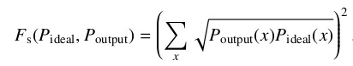
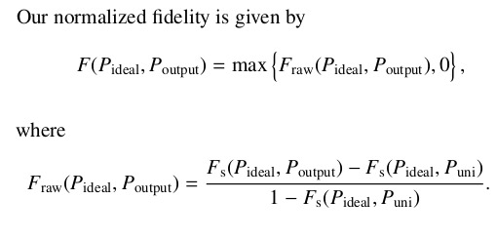
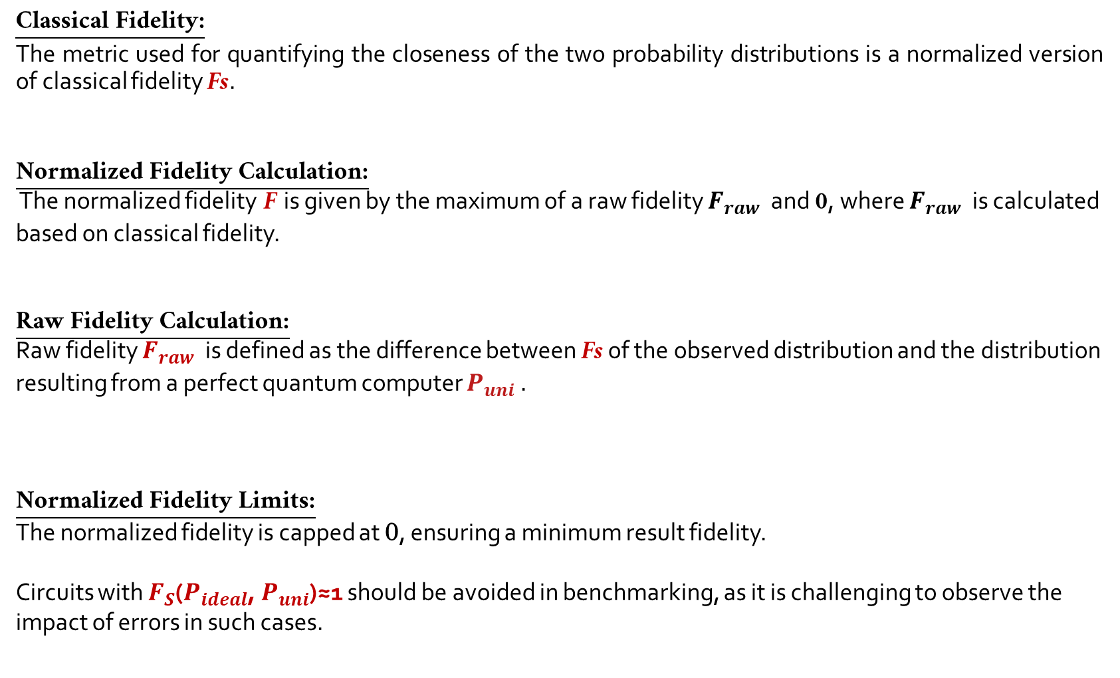
Classical Fidelity:
The metric used for quantifying the closeness of the two probability distributions is a normalized version of classical fidelity Fs​.
Normalized Fidelity Calculation:
The normalized fidelity F is given by the maximum of a raw fidelity $F_{raw}$​ and 0, where $F_{raw}$​ is calculated based on classical fidelity.
Raw Fidelity Calculation:
Raw fidelity $F_{raw}$​ is defined as the difference between Fs of the observed distribution and the distribution resulting from a perfect quantum computer $P_{uni}$​.
Normalized Fidelity Limits:
The normalized fidelity is capped at 0, ensuring a minimum result fidelity.
Circuits with $F_{S}$($P_{ideal}$, $P_{uni}$)≈1 should be avoided in benchmarking, as it is challenging to observe the impact of errors in such cases.

Slide 40
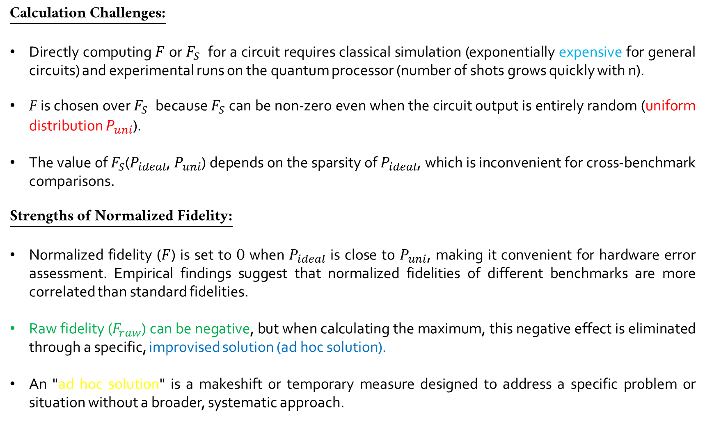
Calculation Challenges:
Directly computing $F$ or $F_{S}$ for a circuit requires classical simulation (exponentially expensive for general circuits) and experimental runs on the quantum processor (number of shots grows quickly with n).
F is chosen over $F_{S}$ because $F_{S}$ can be non-zero even when the circuit output is entirely random (uniform distribution $P_{uni}$).
The value of $F_{S}$($P_{ideal}$, $P_{uni}$) depends on the sparsity of $P_{ideal}$, which is inconvenient for cross-benchmark comparisons.
Strengths of Normalized Fidelity:
Normalized fidelity ($F$) is set to 0 when $P_{ideal}$ is close to $P_{uni}$, making it convenient for hardware error assessment. Empirical findings suggest that normalized fidelities of different benchmarks are more correlated than standard fidelities.
Raw fidelity ($F_{raw}$) can be negative, but when calculating the maximum, this negative effect is eliminated through a specific, improvised solution (ad hoc solution).
An "ad hoc solution" is a makeshift or temporary measure designed to address a specific problem or situation without a broader, systematic approach.

Slide 41
Future Benchmarking Metrics:
Future versions of the benchmarking suite will include multiple metrics for result quality.
Additional metrics like quantum process fidelity and diamond distance will be considered.
Result Fidelity Presentation:
Result fidelity is typically averaged over a circuit ensemble (denoted by F¯).
Presentation includes average result fidelity, circuit widths, and normalized depths.
The data is visualized, showcasing the relationship between fidelity, circuit width, and depth.
Visualization Method:
Volumetric background plots are the primary method for visualizing benchmark results.
Reference to Future Work:
The term "result fidelity" specifically refers to the normalized fidelity (F).
The possibility of computing other statistics of result fidelities is acknowledged.
Techniques for measuring process fidelity are expected to be added in the future.

Slide 42
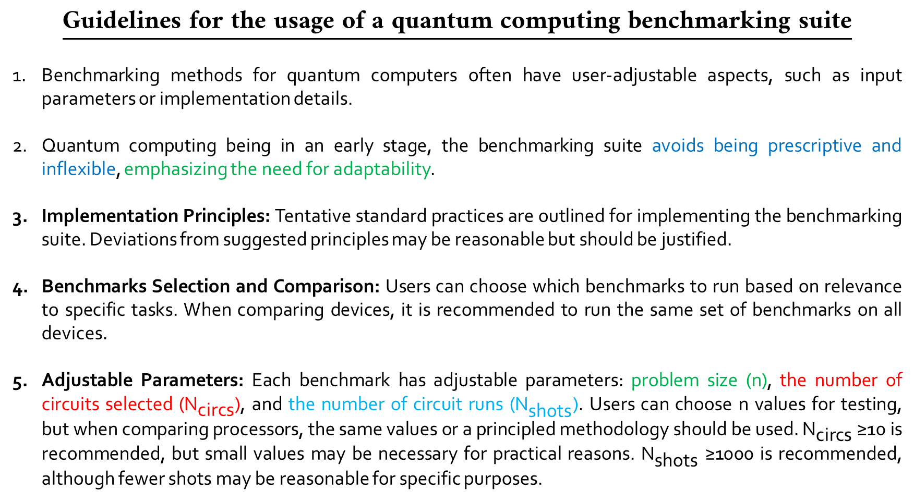
Guidelines for the usage of a quantum computing benchmarking suite
Benchmarking methods for quantum computers often have user-adjustable aspects, such as input parameters or implementation details.
Quantum computing being in an early stage, the benchmarking suite avoids being prescriptive and inflexible, emphasizing the need for adaptability.
Implementation Principles: Tentative standard practices are outlined for implementing the benchmarking suite. Deviations from suggested principles may be reasonable but should be justified.
Benchmarks Selection and Comparison: Users can choose which benchmarks to run based on relevance to specific tasks. When comparing devices, it is recommended to run the same set of benchmarks on all devices.
Adjustable Parameters: Each benchmark has adjustable parameters: problem size (n), the number of circuits selected (${\text{N}}_{\text{circs}}$), and the number of circuit runs (${\text{N}}_{\text{shots}}$). Users can choose n values for testing, but when comparing processors, the same values or a principled methodology should be used. ${\text{N}}_{\text{circs}}$ ≥10 is recommended, but small values may be necessary for practical reasons. ${\text{N}}_{\text{shots}}$ ≥1000 is recommended, although fewer shots may be reasonable for specific purposes.

Slide 43
Error Mitigation Strategies: Benchmarking suites are important for testing strategies that help deal with errors in quantum computing. Some strategies, such as substituting real data with perfectly simulated data, are seen as impractical. It is recommended to provide clear and detailed explanations of error mitigation strategies to ensure transparency and understanding.
Compilation Challenges: Compiling benchmarking circuits into logically equivalent ones is allowed for end-to-end stack performance reflection. Challenges arise when efficiently classically simulatable circuits are involved.
Future Enhancements: Future versions may include explicit rules for allowed compilations for each benchmarking circuit. Flexibility and user-specifiable compiler restrictions are desirable.
Role in Innovation: Benchmarking suites allow testing and comparing error mitigation strategies but should avoid restricting innovation.

Slide 44
BENCHMARK RESULTS AND ANALYSIS
Benchmark Results on a Quantum Simulator
Execution of the entire suite of benchmark programs results in a data file that stores all of the metrics collected for the tested device. Plotting all of the accumulated average result fidelity data on a single volumetric background produces charts like the ones shown in figure (in the next slide), which were generated by running our benchmarks on the Qiskit Aer simulator.
These simulations used all-to-all connectivity between the qubits, and a simple error model in which each n-qubit gate was subject to n-qubit depolarizing errors, for n = 1, 2.
For the simulation that generated the upper plot of Figure, the one- and two-qubit gate error rates were 0.003 and 0.03, respectively. These error rates are similar to those found in some current devices (note that current devices suffer more complex, structured forms of error than pure depolarization). The quantum volume was determined to be 32, by executing the quantum volume protocol directly on this simulator, and this was used to generate the volumetric background.
For the lower plot of Figure, the one- and two-qubit gate error rates were 0.0005 and 0.005, respectively, resulting in a quantum volume of 2048.

Slide 45
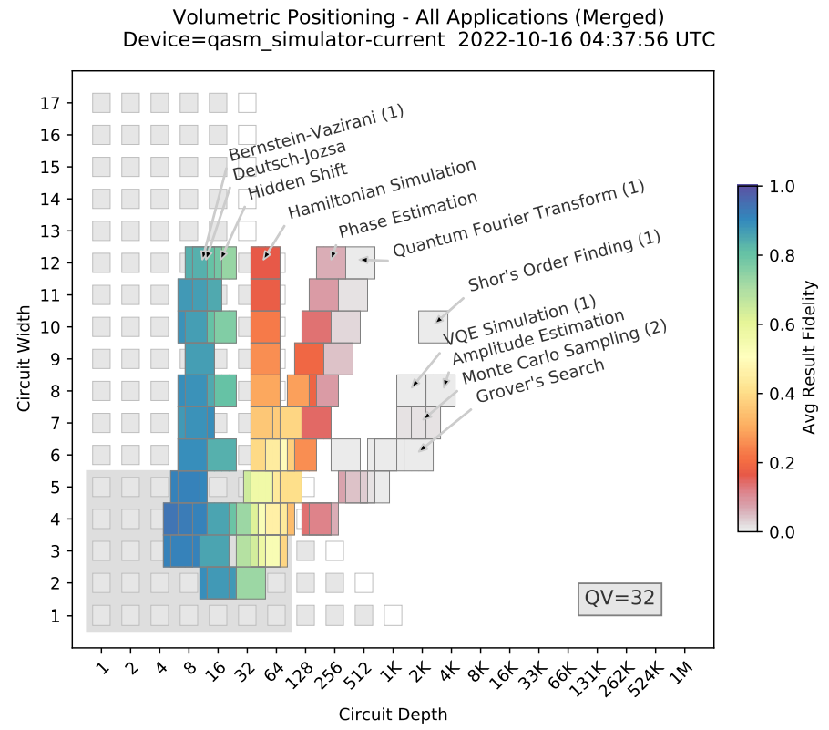

Slide 46
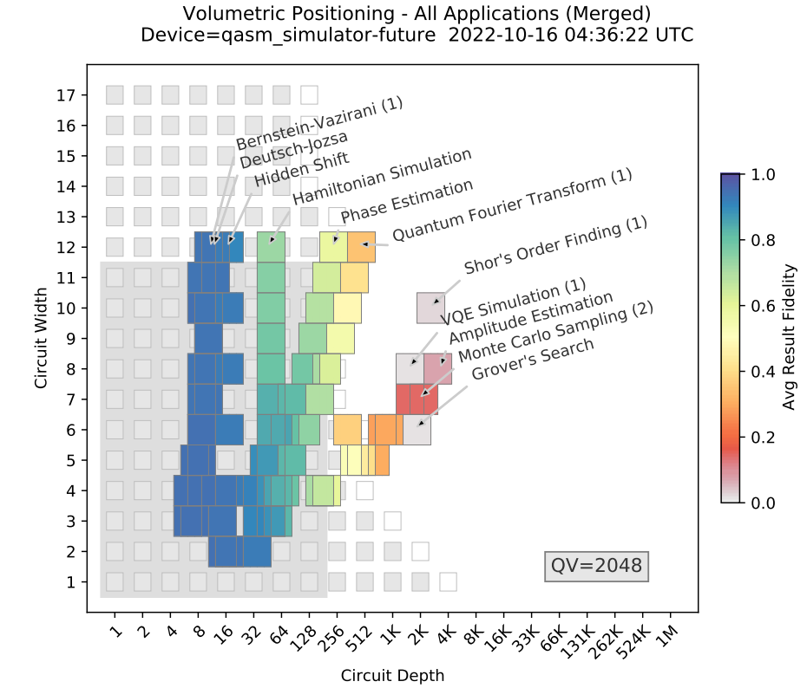

Slide 47
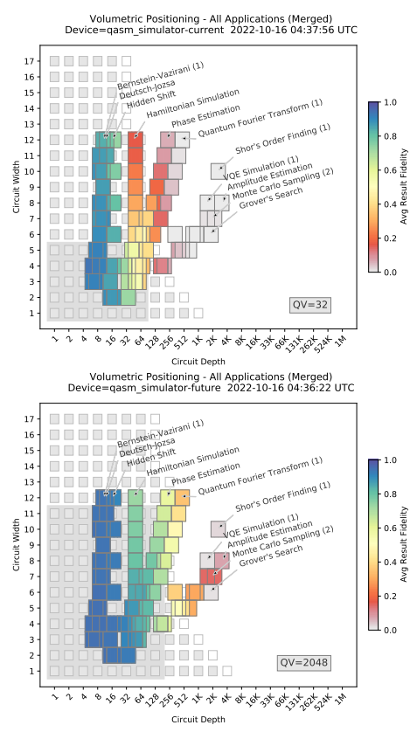
Figure: Demonstrating our benchmarks on a quantum simulator. Results from running our suite of application-oriented benchmarks on a quantum simulator (colored squares) on top of a volumetric background (grey-scale squares) extrapolated from the quantum volume. The simulator uses all-to-all qubit connectivity and two different error rate scales that result in quantum volumes of 32 and 2048, as shown in each plot. Each volumetric background is extrapolated from the quantum volume using a simple heuristic that is designed to predict the regions in which a circuit’s result fidelity will be above 1/2.

Slide 48
For both plots in Figure, there is close agreement between the average result fidelities of all the application benchmarks. There is also close agreement between the application benchmarks and the volumetric background. This is expected here due to the simplicity of the error model and the use of all-to-all connectivity.
For more complex errors (e.g., coherent errors) the exact structure of a circuit can impact its performance, as errors can, e.g., coherently add or cancel. This means that circuits of the same shape can have very different performance, potentially resulting in significant differences between a device’s performance on different applications.
Similarly, if there is limited qubit connectivity, after a circuit is transpiled to a device’s primitive gates there can be an increase in the circuit depth that is large and strongly dependent on both the application and the device’s connectivity.
This can cause a sharper decrease in performance with increasing circuit width than anticipated by a volumetric background extrapolated from the quantum volume (using our simple heuristic), and this result fidelity decrease can be application dependent. We observe some of these effects in our experimental results.

Slide 49
B. Benchmark Results on Quantum Hardware
This section present the results of executing application-oriented benchmarks on various providers’ hardware. This section is not intended to perform or highlight comparisons between different systems, but rather to demonstrate our benchmarking suite.
Quantum computing hardware is changing rapidly, and we did not have access to the latest hardware from all providers. Any comparisons would be quickly outdated, and therefore potentially misleading or erroneous.

Slide 50
Rigetti Computing
Quantum Computer and Service:
Rigetti Computing provides quantum computers based on superconducting qubit technology.
Users can access Rigetti's quantum devices through the Amazon Braket Service.
Benchmark Execution:
Subset of benchmarks, including Hidden Shift and QFT(2), were executed on Rigetti Aspen-9.
Circuit Width and Result Fidelity:
The result fidelity is shown as a function of the circuit width (number of qubits) for the Hidden Shift and QFT(2) benchmarks.
The Hidden Shift benchmark was executed on the first 8 qubits, while QFT(2) was executed on the first 6 qubits.
Fidelity Decay:
Result fidelity decreases as the circuit width increases, which is an expected behavior.
Various factors, including qubit connectivity, contribute to the specific form of fidelity decay observed.

Slide 51
Qubit Connectivity Impact:
Controlled rotation gates between non-connected qubits are used in the benchmarks.
Limited qubit connectivity leads to the need for multiple two-qubit gates between pairs of connected qubits.
The results reflect the impact of limited qubit connectivity on benchmark execution.
Benchmark Applicability:
The benchmarks are not tailored to utilize the subset of qubits with the best connectivity for specific applications.
Results represent the user experience when executing applications using qubits 1 through n for an n-qubit circuit.
Provider compilers may employ intelligent qubit selection strategies to optimize performance.

Slide 52
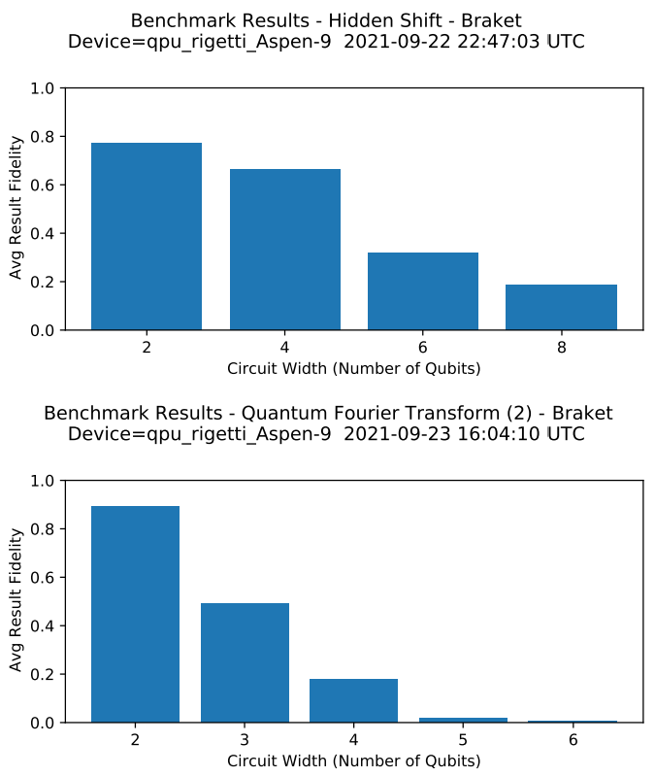
Figure: Demonstrating two benchmarks on Rigetti Aspen-9. The result fidelity observed when running our Hidden Shift benchmark (upper plot) and QFT(2) benchmark (lower plot) on Rigetti Aspen-9. For each benchmark, we show the average result fidelity as a function of circuit width (the number of qubits). (Data collected via cloud service.)

Slide 53
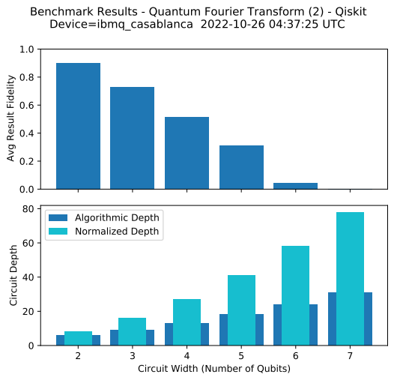
IBM Quantum
IBM Quantum provides a large selection of quantum computing devices through IBM Quantum Services. IBM Q’s devices are based on superconducting qubit technology.
In further slides, we present results from several of those machines.
Note: there are larger and more recent IBM Q systems, including systems that have larger quantum volumes than those that we tested.
Figure: Demonstrating a QFT-based benchmark on IBM Q Casablanca. Results from running the QFT(2) benchmark, the second of our two QFT-based benchmarks, on IBM Q Casablanca. The upper and lower plots show the average result fidelity and circuit depth, respectively, as a function of circuit width (the number of qubits).

Slide 54
Figure shows results from running the QFT(2) benchmark on IBM Q Casablanca, which is a 7 qubit device. We show the average result fidelity and average circuit depth as a function of the circuit width (the number of qubits).
The lower plot of the figure shows both the normalized circuit depth and the depth of the circuits when written in the high-level API used to define the benchmark.
Note: neither of these depths correspond to the depth of the circuits after they have been transpiled to the device’s native operations (i.e., the circuit’s physical depth), which will typically be larger.

Slide 55
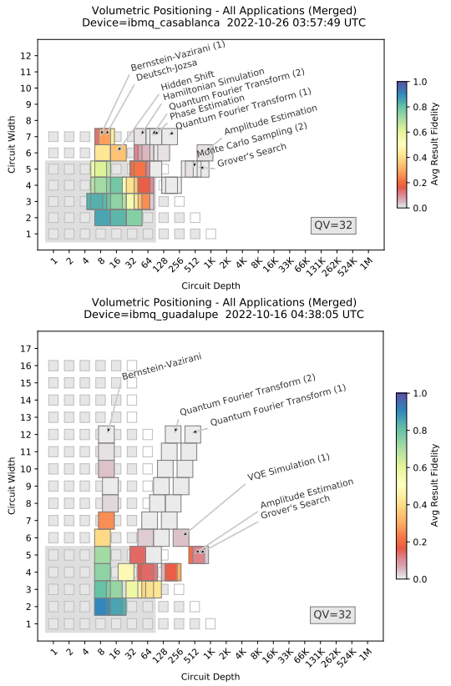
Figure shows the results of running a subset of the benchmarking suite on IBM Q Casablanca and IBM Q Guadalupe. IBM Q Casablanca and IBM Q Guadalupe are 7 and 16 qubit devices, respectively, that both have a quantum volume of 32.
Figure: Benchmarking results on IBM Q Casablanca and Guadalupe. The result fidelities obtained when running subsets of the benchmarking suite on IBM Q Casablanca and IBM Q Guadalupe. The volumetric backgrounds (grey squares) extrapolated from each device’s quantum volume (32 in both cases) do not accurately predict the performance of wide circuits on IBM Q Guadalupe.

Slide 56
Some of these benchmarks use circuits with a depth of well over 1000 (e.g., Grover’s Search benchmark), and we observed low result fidelities for all such circuits. All application circuits whose volumetric positions are in the region predicted to have low result fidelity by the volumetric background (white squares and blank region) do have low result fidelities.
However, there are application circuits with low result fidelities (e.g., red squares) whose volumetric positions fall within the high result fidelity region of the volumetric background (grey squares). We observe that performance drops off with increasing width much more quickly than predicted by the volumetric background.
This is likely primarily because this volumetric background is extrapolated from the quantum volume using a simple heuristic that does not account for a device’s connectivity. This could potentially be addressed with a more sophisticated heuristic, or by instead using measured volumetric backgrounds.
Mid-circuit measurement and qubit reset to make qubits reusable is a recent quantum computing enhancement, and IBM has introduced this feature for some of their systems. Our benchmark suite has been designed so that it can be adapted to include circuits that utilize mid-circuit measurements.

Slide 57
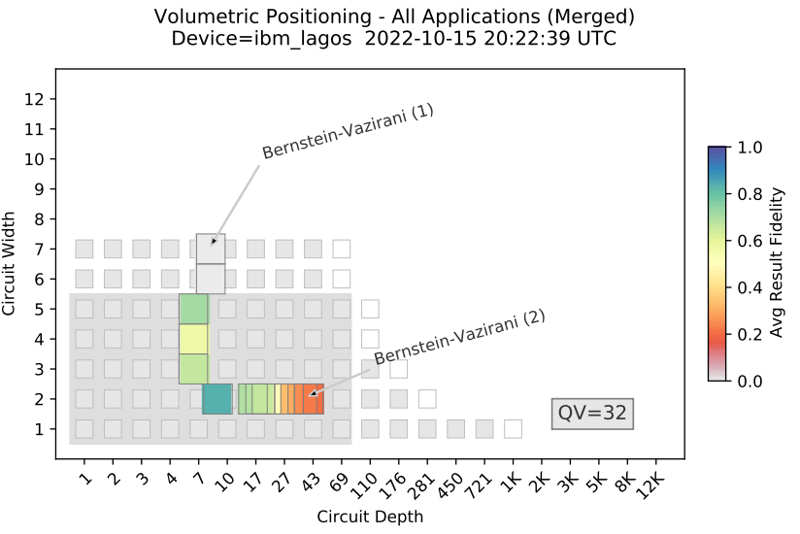
Figure: Benchmarks that use mid-circuit measurements. Results from running the Bernstein-Vazirani(1) and Bernstein-Vazirani(2) benchmarks on IBM Q Lagos. These benchmarks are based on two different implementations of the Bernstein-Vazirani algorithm: Bernstein-Vazirani(1) uses n + 1 qubit circuits for n-bit inputs, whereas Bernstein-Vazirani(2) uses mid-circuit measurements to reuse one of the qubits, and therefore needs only 2 qubits for any size input. Both benchmarks use the same random 2-6 bit algorithm inputs. We observe higher result fidelity when using mid-circuit measurements to reduce the width of the circuits.

Slide 58
Figure shows the results of executing two benchmarks, constructed from the Bernstein-Vazirani algorithm, on IBM Q Lagos, which is a 7 qubit device. In both versions of the benchmark, the algorithm’s input is an n bit integer, and on IBM Q Lagos n ranges from 2 to 6.
In the Bernstein-Vazirani(1) benchmark, an n bit integer input uses an n+1 qubit circuit, so the circuit widths range from 3 to 7.
In the Bernstein-Vazirani(2) benchmark, an n bit integer input uses only 2 qubits for all n, one of which is repeatedly reset and reused with the aid of mid-circuit measurements. This results in width 2 circuits for all n.
In Figure, we observe that the result fidelity drops precipitously when the width of the circuit exceeds 5, which places it outside the quantum volume region (the grey rectangle).
In the Bernstein-Vazirani(2) benchmark, the circuits’ widths do not exceed 2, and we observe a larger result fidelity for the same problem instances. This illustrates the potential value of mid-circuit measurements for increasing an algorithm’s result fidelity.

Slide 59
Quantinuum
Quantinuum System Model H1.1 was released commercially in 2020. This quantum computing system currently encodes up to 12 qubits in trapped atomic ions using the quantum charged coupled architecture. The qubits are fully connected by using ion transport operations to rearrange the ions to interact any pair of qubits. The system has an average single-qubit gate fidelity of 99.99(1)% and average two-qubit gate fidelity of 99.70(5)%, as measured using standard randomized benchmarking. The system is also capable of applying high-fidelity mid-circuit measurement and reset to any qubit.
Figure (in the next slide) shows the results of executing a subset of our application-oriented benchmarks on the Quantinuum H1-1. For these tests the code was slightly edited to more easily run with the Quantinuum API but the qiskit version is also supported.
These results show that the Quantinuum system can run 12-qubit, moderate-depth circuits that contain interactions between many pairs of qubits and still obtain moderate to high fidelity results.
The Bernstein-Vazirani(1), Hidden-Shift, and Hamiltonian Simulation benchmarks all return high fidelity results (F¯ ≥ 0.77) for all qubit numbers up to the 12 qubit system size limit. Benchmarks that require deeper circuits, such as the QFT(1) and QFT(2) benchmarks and the Phase Estimation benchmark, still produce results that are distinguishable from random outputs.

Slide 60
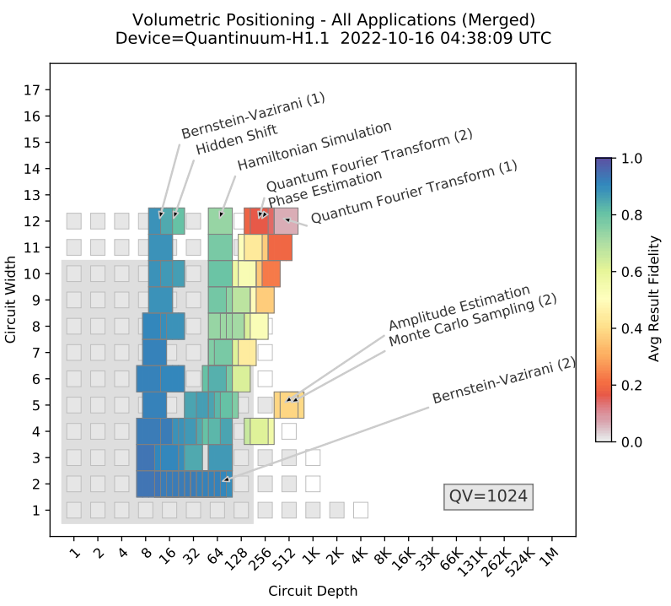
Figure: Benchmark results on Quantinuum’s H1.1. The result fidelities obtained when running our benchmarking suite on H1.1, which is a 12-qubit device. Each benchmark was run with 500 shots and at most five random circuits per qubit number. For all wide and shallow circuits the result fidelity is high. Quantinuum has measured the quantum volume of this device to be 1024, and this value is used to construct the volumetric background region. The volumetric background is broadly predictive of the performance of our algorithmic benchmarks.

Slide 61
The smallest fidelity for the QFT (1) was F¯ = 0.07, which was obtained for the case of n = 12. Overall, we observe that the volumetric background extrapolated from a quantum volume of 1024 provides a broadly, but not entirely, accurate prediction of the performance of our algorithmic benchmarks.
The H1.1 can implement mid-circuit measurement and reset operations, which we benchmarked using the Bernstein-Vazirani(2) benchmark. While both our benchmarks based on the Bernstein-Vazirani algorithm achieve high fidelity results (F¯ > 0.929), Bernstein-Vazirani(2) performs slightly better than Bernstein-Vazirani(1) for larger register size.
The Bernstein-Vazirani(2) benchmark can also be implemented for larger algorithm input sizes (n > 12) as it only uses two qubits for any input, whereas the Bernstein-Vazirani(1) benchmark is limited to n ≤ 12 due to the machine’s current restriction to 12 qubits

Slide 62
IonQ
IonQ is a provider of quantum computers that are available via Amazon Braket, Microsoft Azure Quantum and Google Cloud. IonQ systems support most leading quantum programming environments, and we executed our benchmarks on the IonQ system using the Qiskit provider module supplied by IonQ. Their hardware utilizes trapped ytterbium ions where qubits are encoded in two states of the ground hyperfine manifold. The IonQ system currently on the cloud consists of 11 qubits that are fully connected.
Figure (in the next slide) shows results from executing a subset of the application-oriented benchmarks on the IonQ system. IonQ does not publish a quantum volume metric for this device, and we chose not to run the quantum volume circuits on any of the tested hardware.
In Figure we observe high-fidelity results for the Bernstein-Vazirani(1), Deutsch-Jozsa and Hidden Shift benchmarks for all qubit numbers, up to the current system limit of n = 11.
For benchmarks that use deeper circuits we observe a steeper decrease in result fidelity with n, and the observed performance is broadly, but not entirely, consistent with the predictions of the volumetric background.

Slide 63
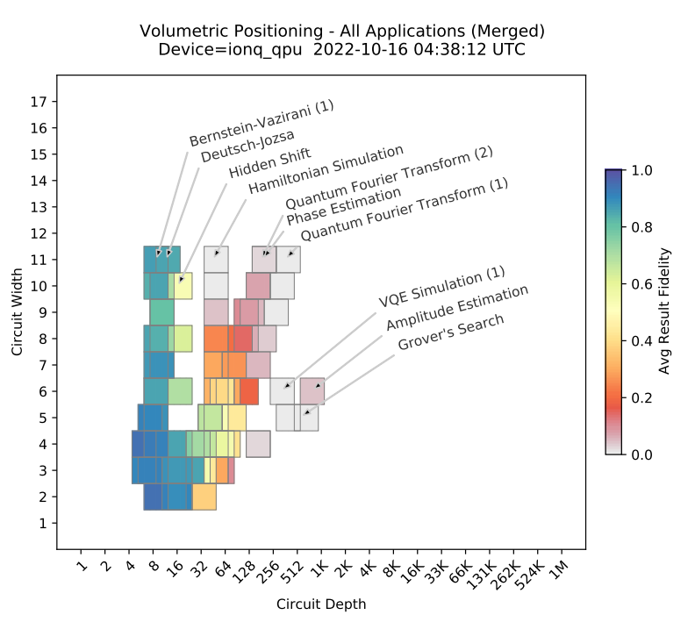
Figure: Benchmark results on IonQ’s cloud-accessible system. The result fidelities obtained when running our benchmarking suite on IonQ’s Harmony cloud-accessible system, which features 11 qubits. For all wide and shallow circuits the result fidelity is high. IonQ does not publish a quantum volume for this device, and we did not measure it directly, so we do not include a volumetric background in this plot.

Slide 64
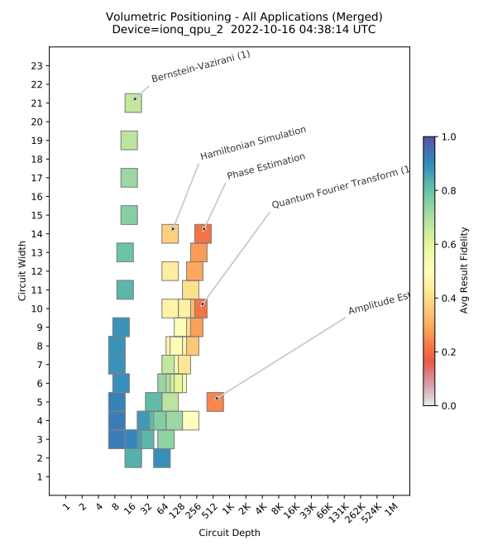
Figure: Benchmark results on IonQ’s Aria system. The result fidelities obtained when running our benchmarking suite on up to 21 qubits of IonQ’s Aria system. We observe a significant performance improvement in comparison to the previous generation of IonQ hardware. IonQ does not publish a quantum volume for this device, and we did not measure it directly, so we do not include a volumetric background in this plot.

Slide 65
IonQ has recently introduced its next-generation quantum hardware. This hardware is purported to feature an order of magnitude reduction in gate error rates in comparison to IonQ’s current system on the cloud.
Figure (in previous slide) shows the results from running a subset of our benchmarking suite on this device, including benchmarks from all 3 categories in Table I. We observe a significant increase in performance in comparison to the previous generation hardware, as is apparent by comparing above Figures.
For instance, the Bernstein-Vazirani(1) benchmark is run for up to 21 qubits, and the result fidelity for the largest circuit is 70%. This can be compared with the result fidelity for the largest circuit for the Bernstein Vazirani(1) benchmark on the cloud quantum computer, which is 78% for 11 qubits.
Note: the maximum width and depth of the Hamiltonian Simulation and Phase Estimation benchmark circuits here exceeds that in all other IonQ experiments, as here we tested up to 14 qubits

Slide 66
Compatible Hardware
Our application-oriented benchmarking suite is designed to be applicable to any gate-based quantum computer, and our implementation of that suite is applicable to any platform that can be interfaced with Qiskit, Cirq, Braket, or Q#.
Table II contains a non-exhaustive list of hardware that that we did not test in this work but that is compatible with our implementation of our benchmarking suite.
Note that support for different quantum hardware devices by these programming environments will evolve over time.
Hardware | Programming Environment
Google QCS | Cirq
Alpine Quantum Technologies | Qiskit Cirq
TABLE II: The Application-Oriented Benchmark Suite introduced in this work can be executed on other quantum computing hardware, using the programming environments specified.

Slide 67
Comparison to Generic Benchmarks :
A volumetric background is a prediction for the result fidelity of circuits, as a function of circuit shape (i.e., volumetric position), that is constructed from the results of some independent benchmark or performance data.
We have considered only volumetric backgrounds that are extrapolated from a single performance metric: the quantum volume.
Our simulated and experimental results show that this extrapolated volumetric background can provide reasonably accurate predictions of application performance in some instances (particularly with all-to-all connectivity devices) but not always. All-to-all connectivity in the context of quantum computing refers to a specific arrangement of qubits within a quantum processor or quantum device.

Slide 68
Problems with Volumetric Background :
There are many reasons why we should not expect our volumetric background extrapolated from the quantum volume to always accurately predict performance.
Device Connectivity: The simple heuristic used in the extrapolation might overlook the nuances of device connectivity. Quantum systems have specific architectures and connectivity limitations. Extrapolation methods that don't account for these connectivity constraints might not accurately represent how algorithms will behave on devices with different qubit interactions and connectivity patterns. The effectiveness of quantum algorithms can significantly vary based on the topology and connectivity of the quantum processor.
Circuit Size Discrepancy: Extrapolating quantum volume to predict the performance of circuits with significantly more qubits than those used in the quantum volume experiments can lead to inaccuracies. As circuit size increases, the behavior of quantum algorithms might not scale linearly or predictably. Complex interactions between a larger number of qubits, increased error rates, and noise accumulation could impact performance in ways that are not accounted for in the extrapolation.

Slide 69
Volumetric Background with Randomized mirror circuits:
It is difficult for any generic benchmark to reliably predict the performance of a diverse suite of algorithms.
To achieve this, suite follows an alternative approach to volumetric backgrounds based on Quantum Volume with “ Volumetric backgrounds created by running Randomized Mirror Circuits”.
For this illustrative comparison, we focus on a single device, IBM Q Casablanca, and the particular class of randomized mirror circuits used in Timothy Proctor, Kenneth Rudinger, Kevin Young, Erik Nielsen, and Robin Blume-Kohout. Measuring the capabilities of quantum computers, 2020.
Randomized Mirror Circuits: Mirror circuits are a specific class of quantum circuits that have properties making them useful for benchmarking quantum computer performance. Randomized mirror circuits are a variation of these circuits where certain gates or operations are applied randomly or in a specific randomized sequence.

Slide 70
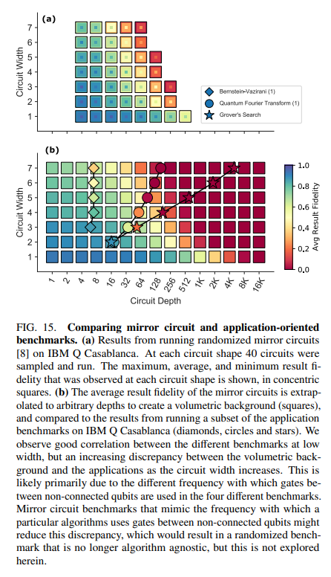
Fidelities obtained when running randomized mirror circuits on IBM Q Casablanca :
We use the data in Figure 15 (a) to construct a volumetric background by
By running multiple instances of randomized mirror circuits of a given shape on a quantum computer, one can calculate the average result fidelity obtained from these executions. This average fidelity serves as a predictor or metric for the performance of circuits with a similar structure or shape.
Extrapolating this to all circuit depths using the theory for randomized mirror circuits presented in (Timothy Proctor, Stefan Serita, Erik Nielsen, Robin Blume Kohout, and Kevin Young. Scalable randomized benchmarking of quantum computers using mirror circuits. In preparation.) to predict the behavior of circuits at various depths (number of sequential layers or gates) beyond those explicitly tested.
This methodology essentially leverages the average fidelity obtained from randomized mirror circuits as a proxy or predictor for the performance of circuits with similar characteristics.

Slide 71
Fidelities obtained when running randomized mirror circuits on IBM Q Casablanca : (contd.)
This volumetric background is shown in previous Figure , alongside the average result fidelities of three of our application benchmarks: the Bernstein-Vazirani(1) benchmark, the QFT(1) benchmark, and the Grover’s Search benchmark.
To facilitate a more precise comparison to the results of the application oriented benchmarks, here we
do not average together the results for application-oriented benchmarks with similar volumetric positions, and
we use a color-scale volumetric background.
The general trend of all three benchmarks and the volumetric background are unsurprisingly in agreement: result fidelity decreases with increasing circuit width and depth.
However, there are substantial differences between the rates at which the performance of each type of circuit drops off with increasing circuit size.

Slide 72
Discrepancy between the result fidelity of randomized mirror circuits and algorithmic benchmarks :
There are multiple possible reasons for the observed discrepancy between the result fidelity of randomized mirror circuits and algorithmic benchmarks.
Differing Gate Requirements: Each circuit family (the algorithms and randomized mirror circuits) might require a different number of physical two-qubit gates even at a fixed normalized circuit depth. This discrepancy arises due to the inherent structural differences in these circuits. For instance, one algorithm might involve more or fewer two-qubit gates compared to others, affecting the overall gate count.
Standardized Gate Set and Connectivity: When these circuits are transpiled into a standardized gate set with all-to-all connectivity (used to define normalized circuit depth), they might still use different average numbers of two-qubit gates at a fixed depth. The use of different gate sets or connectivity constraints can impact the gate count and the overall structure of the circuit.
Variation in Qubit Coupling and Connectivity Overhead: Each circuit family may have varying rates at which qubits are coupled or interact with each other. When transpiling these circuits to the physical gate set of a specific quantum device with limited connectivity (like IBM Q Casablanca), the differing qubit couplings will result in different CNOT (Control-NOT) gate overheads. Limited connectivity requires additional SWAP or routing operations, introducing additional gates and potentially impacting fidelity. The randomized mirror circuits incur no CNOT overhead at this transpilation stage, as they were designed to contain only CNOT gates between connected qubits.

Slide 73
Discrepancy between the result fidelity of randomized mirror circuits and algorithmic benchmarks : (contd.)
The physical CNOT count discrepancy will typically increase with the number of qubits (i.e., circuit width), which explains the faster result fidelity decrease with circuit width that we observe for the application benchmarks versus the randomized mirror circuit.
It is possible to design randomized mirror circuits that use the same number of physical CNOT gates as any given application benchmark (on average and at a given depth d), but this physical CNOT density varies between algorithmic benchmarks—so any randomized benchmark that is designed to match this density is no longer algorithm agnostic.
The discrepancies between the results of our application oriented benchmarks and both the volumetric backgrounds inferred from randomized mirror circuit data and from a device’s quantum volume are indicative of the challenges associated with predicting algorithm performance from generic benchmarks.
One way to potentially remove the discrepancy is to use physical depth to define a circuit’s volumetric position.

Slide 74
Impact of Compiler Optimization Techniques
Let's delve into the influence of compiler optimization techniques on quantum computing experiments, with a particular emphasis on the IBM Q Guadalupe device as an illustrative example.
Default Settings and User Interaction:
The experiments were conducted using the default settings provided by the quantum computing hardware provider for transpilation and execution of circuits.
Many quantum programming packages offer compilation options that allow users to modify circuits based on device characteristics, such as qubit connectivity or timing parameters.
Users often face challenges in determining the optimal parameters for a target device, and providers may exclude automatic optimization techniques to avoid interfering with user customizations.

Slide 75
Compiler Optimization Impact on Fidelity:
Figure (in the next slide) illustrates the impact of a compiler optimization and layout strategy on the IBM Q Guadalupe device.
The optimization, in this case, improves the fidelity significantly for wide and shallow circuits by optimizing the layout based on qubit connectivity.
Qiskit execution method was configured with optimization_level = 3, providing high circuit optimization, albeit with a longer execution time for the classical circuit optimizer.
Additional configuration included layout_method = 'sabre' and routing_method = 'sabre', utilizing information about the connectivity of the target device for optimal circuit layout and routing interactions between qubits.

Slide 76
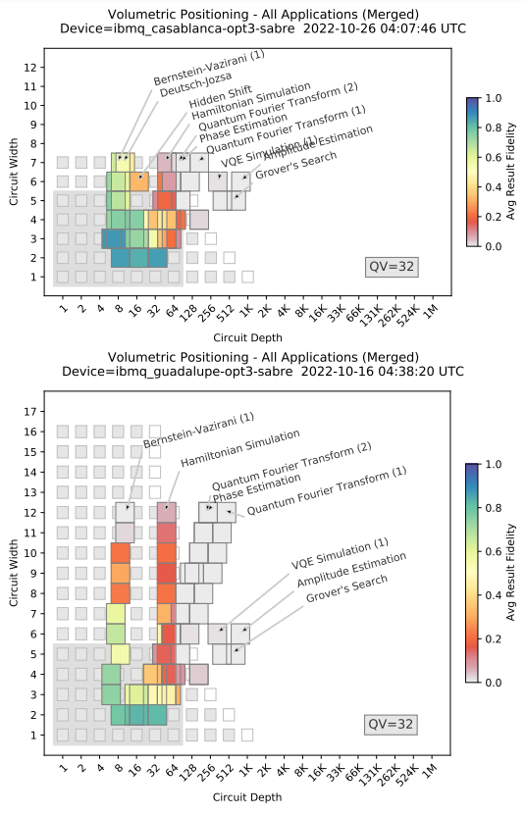
Figure: Benchmarking results on IBM Q Casablanca and Guadalupe with compiler optimizations. The result fidelities obtained when running a subset of our benchmarking suite on the IBM Q Casablanca and Guadalupe systems using the compiler optimization strategy defined in the text. There is an improvement in result fidelity for wide circuits, as compared with the results shown in Figure for IBM Quantum.

Slide 77
Arbitrary Angle Two-Qubit Gates:
In the H1.1 system, arbitrary angle two-qubit gates were used to implement the QFT(1) and QFT(2) benchmarks.
Trapped-ion systems typically implement two-qubit gates using the Mølmer-Sørenson interaction with a fixed laser power, resulting in a specific unitary exp[−i(π/4)XX], which is equivalent to CNOT up to local unitary.
The use of arbitrary angle gates, achieved by varying the laser power, allows for a controlled-Z(θ) operation with potential benefits, such as reducing the number of two-qubit interactions and decreasing errors.
The QFT(1) and QFT(2) benchmarks show a significant improvement in fidelity when using arbitrary angle gates.
For example, for QFT(1) without arbitrary angle gates the fidelity for n = 12 qubits was 0.07 but with the arbitrary angle gates it had a 3× improvement to 0.216.

Slide 78
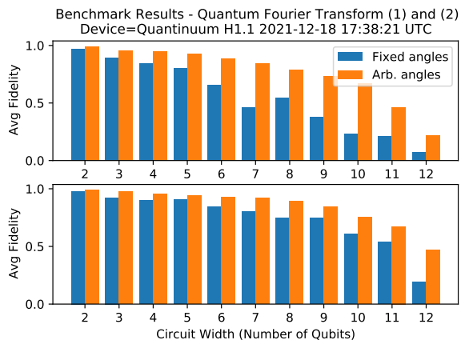
Figure: Benchmarking results on Quantinuum’s H1.1 with compiler optimizations. The result fidelities obtained when running a subset of our benchmarking suite on H1.1 using arbitrary angles. For both QFT-based benchmarks the number of two-qubit interactions is roughly cut in half and the errors are further reduced by decreasing the angle of two-qubit rotations

Slide 79
Measuring Execution Time :
Most existing quantum computing benchmarks focus on measuring result quality, but the time taken to run an application is also an important metric of performance .
In particular, the time to solution is a crucial metric when comparing quantum and classical computations, e.g., comparing quantum and classical compute times was central to recent demonstrations of quantum advantage.
This benchmarking suite is designed to quantify various aspects of the time to solution.

Slide 80
Total Execution time :
The total time required to execute a complete quantum application is called Total execution time. It is a critical aspect of a quantum computer’s performance.
To get detailed understating of the performance, total execution time is divided into times taken for sub-tasks (ex: Circuit Compilation). Ideal benchmarking suite will measure each of these.
In general, a quantum application is a hybrid quantum-classical computation consisting of running one or more quantum circuits interleaved with classical processing.
So there are some computational times that are needed to be considered.
Compilation Time
Classical Computation Time
Quantum Execution Time

Slide 81
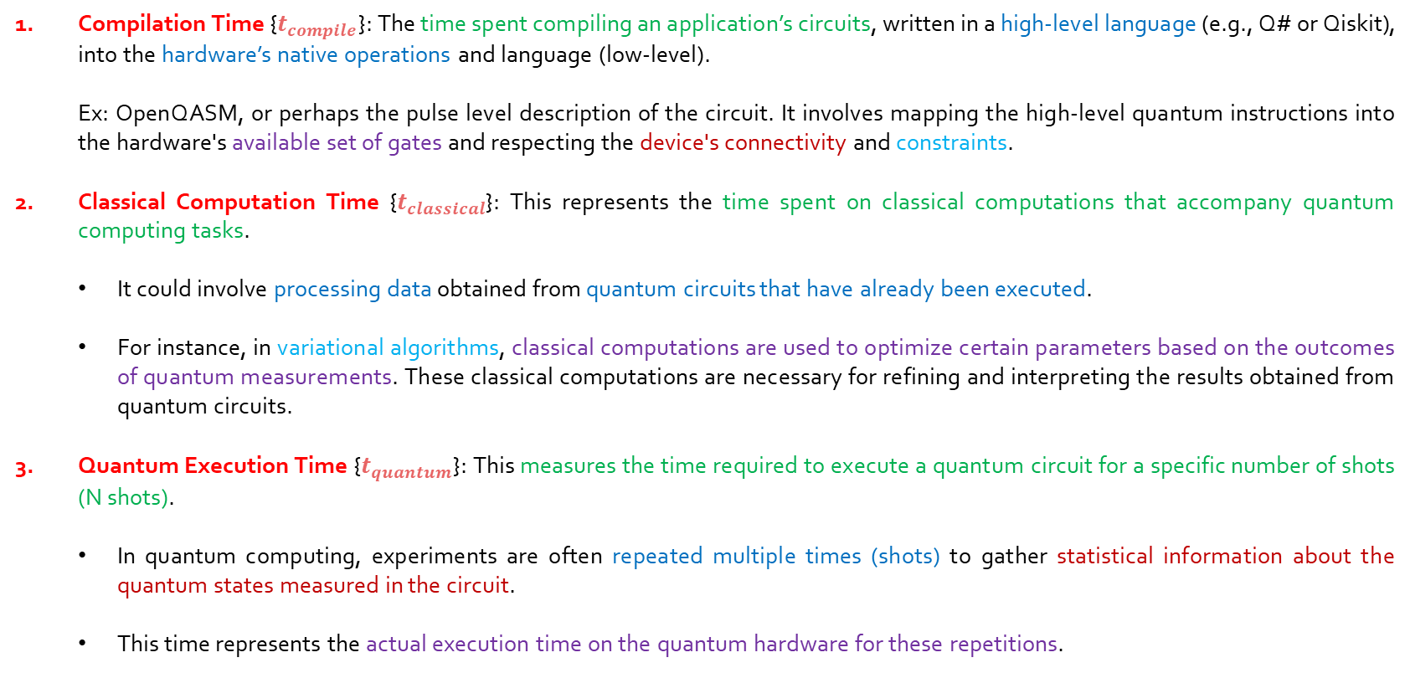
Compute times associated with Total time :
Compilation Time {$t_{compile}$}: The time spent compiling an application’s circuits, written in a high-level language (e.g., Q# or Qiskit), into the hardware’s native operations and language (low-level).
Ex: OpenQASM, or perhaps the pulse level description of the circuit. It involves mapping the high-level quantum instructions into the hardware's available set of gates and respecting the device's connectivity and constraints.
Classical Computation Time {$t_{classical}$}: This represents the time spent on classical computations that accompany quantum computing tasks.
It could involve processing data obtained from quantum circuits that have already been executed.
For instance, in variational algorithms, classical computations are used to optimize certain parameters based on the outcomes of quantum measurements. These classical computations are necessary for refining and interpreting the results obtained from quantum circuits.
Quantum Execution Time {$t_{quantum}$}: This measures the time required to execute a quantum circuit for a specific number of shots (N shots).
In quantum computing, experiments are often repeated multiple times (shots) to gather statistical information about the quantum states measured in the circuit.
This time represents the actual execution time on the quantum hardware for these repetitions.

Slide 82
Total Execution Time: (contd.)
An additional component in the total execution time when using shared-usage cloud-access quantum hardware is the queuing time, i.e., the time that circuits spend in a queue waiting to be executed.
To illustrate the potential utility of measuring different components of total execution time, we consider one aspect of running variational quantum algorithms.
These algorithms involve repeated execution of a parameterized circuit for different parameter values. But this execution can be performed in two ways.

Slide 83
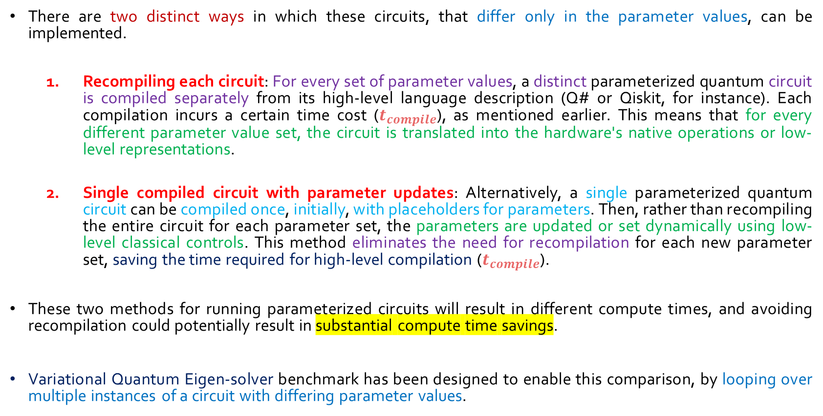
Two ways of executing circuits with varying parameters:
There are two distinct ways in which these circuits, that differ only in the parameter values, can be implemented.
Recompiling each circuit: For every set of parameter values, a distinct parameterized quantum circuit is compiled separately from its high-level language description (Q# or Qiskit, for instance). Each compilation incurs a certain time cost ($t_{compile}$), as mentioned earlier. This means that for every different parameter value set, the circuit is translated into the hardware's native operations or low-level representations.
Single compiled circuit with parameter updates: Alternatively, a single parameterized quantum circuit can be compiled once, initially, with placeholders for parameters. Then, rather than recompiling the entire circuit for each parameter set, the parameters are updated or set dynamically using low-level classical controls. This method eliminates the need for recompilation for each new parameter set, saving the time required for high-level compilation ($t_{compile}$).
These two methods for running parameterized circuits will result in different compute times, and avoiding recompilation could potentially result in substantial compute time savings.
Variational Quantum Eigen-solver benchmark has been designed to enable this comparison, by looping over multiple instances of a circuit with differing parameter values.

Slide 84
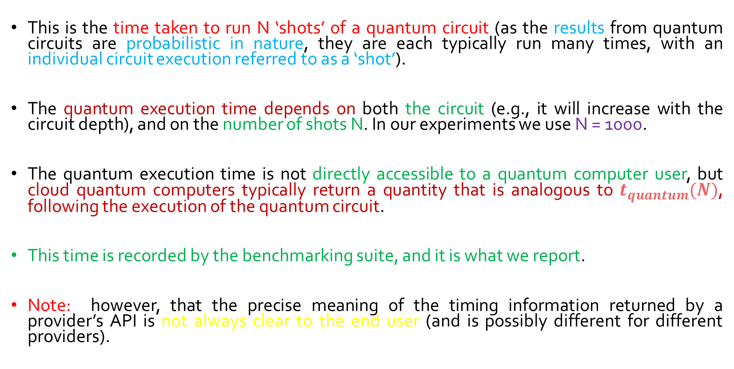
Quantum Execution Time :
This is the time taken to run N ‘shots’ of a quantum circuit (as the results from quantum circuits are probabilistic in nature, they are each typically run many times, with an individual circuit execution referred to as a ‘shot’).
The quantum execution time depends on both the circuit (e.g., it will increase with the circuit depth), and on the number of shots N. In our experiments we use N = 1000.
The quantum execution time is not directly accessible to a quantum computer user, but cloud quantum computers typically return a quantity that is analogous to $t_{quantum}(N)$, following the execution of the quantum circuit.
This time is recorded by the benchmarking suite, and it is what we report.
Note: however, that the precise meaning of the timing information returned by a provider’s API is not always clear to the end user (and is possibly different for different providers).

Slide 85
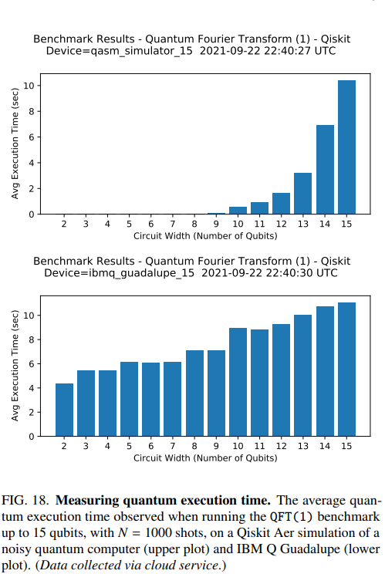
Example of QFT running on Qiskit Aer Simulation and IBM Q Guadalupe:
Following Figure shows the average time to execute the circuits of the QFT benchmark, as a function of circuit width, for a quantum simulator and for IBM Q Guadalupe.
The execution time increases exponentially on the simulator, and linearly on this quantum hardware.
Note that the exponential growth in the time to simulate these circuits does not imply that these circuits are classically hard to simulate , only that this classical simulator exhibits exponential simulation time scaling on these circuits.

Slide 86
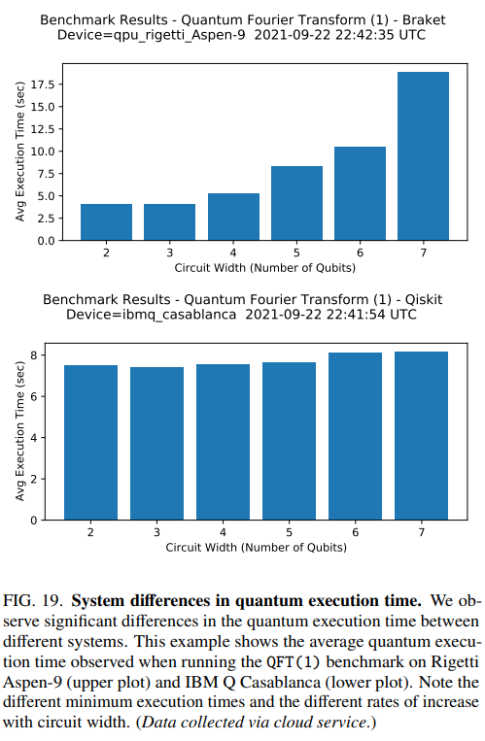
Example of Running QFT benchmark on Rigetti Aspen-9 and IBM Q Casablanca :
Following figure shows results from running the same QFT benchmark on Rigetti Aspen-9 and IBM Q Casablanca.
The Average execution time is shown as a function of the circuit width (the number of qubits) up to 7 qubits.
On IBM Q Casablanca, the execution time is approximately independent of circuit width, suggesting a minimal execution time of ∼ 7 seconds for any circuit. The increase in execution time is small as circuit width and depth increase (although note that this trend should not be naively extrapolated to larger widths and depths).
In contrast, on Rigetti Aspen-9 the minimum execution time is about 4 seconds and there is a steep increase in execution time as circuit width increases (we conjecture that this is because all gates are serialized on Aspen-9, meaning that gates on distinct qubits that could be applied in parallel are applied in serial).
Designers pf suite found that there is significant variation in the execution time profile across the many different devices that they have tested.

Slide 87
SUMMARY AND CONCLUSIONS
Objective and Importance:
Quantum computing is an emerging technology with a wide range of complex errors in existing quantum computers.
There is a need for a robust set of benchmarks and metrics to understand the capabilities of quantum hardware.
The research introduces a suite of quantum application-oriented benchmarks designed to probe the effectiveness of quantum hardware at executing applications.
Benchmark Design:
The benchmark suite is based on well-known quantum algorithms, designed to assess performance as a function of the input problem's size.
Each application benchmark tests quantum computers' performance on variants of the application's quantum circuits.
Measurement of performance includes both result fidelity and quantum execution time, providing proxies for quality and time to solution.

Slide 88
Evolution of the Benchmark Suite:
Acknowledges the limitations of the initial version of the benchmarking suite.
Expects the suite to evolve over time to address limitations and new benchmarking needs, similar to successful classical computing benchmarking suites.
Challenges and Future Research Directions:
Some benchmarks require exponentially expensive classical computations, limiting feasibility for O(100) qubits.
Proposes a general-purpose solution for designing scalable and robust benchmarks.
Calls for further research into delineating and measuring different aspects of total compute time.
Result Quality and Volumetric Benchmarking:
Result quality is primarily summarized using volumetric benchmarking plots, displaying performance as a function of circuit width and depth.
Compares performance on benchmarks to predictions extrapolated from the quantum volume metric.
Suggests a more quantitative comparison between application-oriented benchmarks and application-agnostic benchmarks for future work.

Slide 89
Performance of Tested Hardware:
Indicates that substantial advances are needed for quantum computers to outperform classical counterparts on useful tasks.
Volumetric plots communicate the challenges in achieving quantum advantage, especially for algorithms like Shor's that require large-scale quantum computers with fault-tolerant error correction.
Highlights the potential for advances in algorithms, hardware, and software stack, making the benchmark suite suitable for tracking progress towards useful quantum advantage.
User Adoption and Economic Development:
Cloud-accessible quantum computers attract a wide audience, but understanding their capabilities poses a significant barrier to adoption.
The benchmarking suite facilitates quick assessments of a machine's ability to implement applications.
Anticipates that the suite will encourage the adoption of quantum computing and contribute to economic development in the industry.

Slide 90
Appendix A
(Selected Algorithms and Applications)

Slide 91
Important Terms:
Quantum Superposition: In classical computing, bits can exist in one of two states, 0 or 1. Quantum bits or qubits, on the other hand, can exist in a superposition of states. This means that a qubit can represent both 0 and 1 simultaneously.
Quantum Parallelism: When qubits are in a superposition, quantum algorithms can perform computations on all possible combinations of states at the same time. This is in stark contrast to classical algorithms that would need to consider each combination sequentially.
Interference: Superposition allows quantum algorithms to exploit interference. The interference effect becomes prominent when the superposed states interfere with each other. Quantum interference can amplify the probability of correct outcomes and suppress the probability of incorrect outcomes. This interference phenomenon is used to enhance the desired outcomes and cancel out undesired ones.
Efficiency and Speedup: Quantum algorithms achieve speedup by simultaneously processing multiple possibilities due to superposition. This is particularly advantageous for certain types of problems, such as searching and factoring, where a quantum computer can provide exponential speedup compared to classical counterparts.
Algorithmic Structure: Many quantum algorithms are designed to take advantage of superposition. The algorithms often start by placing qubits in a superposition to explore multiple solution paths concurrently.

Slide 92
6. Quantum Gates: Quantum gates are the basic building blocks of quantum circuits. They are analogous to classical logic gates but operate on quantum bits (qubits) instead of classical bits. Quantum gates manipulate the quantum state of qubits, and they are represented mathematically by unitary matrices.
7. Controlled Operations (or Controlled Gates): A controlled operation is a quantum operation where the application of the gate depends on the state of one or more "control" qubits. If certain conditions are met, the gate is applied to the "target" qubit. Controlled gates are crucial in quantum algorithms, as they allow for the creation of entanglement and the implementation of quantum algorithms.
8. Control Qubit and Target Qubit:
Control Qubit: The qubit whose state determines whether the gate will be applied to the target qubit. If the control qubit is in a specific state (often denoted as |1⟩), the gate will have an effect on the target qubit.
Target Qubit: The qubit on which the gate operation is applied if the control qubit satisfies the specified condition. The target qubit is the one whose quantum state is manipulated by the gate.
9. Controlled Quantum Gate Operations: Quantum gates that are controlled are denoted as controlled-X (CNOT), controlled-Z, etc. The controlled-X gate, for example, applies a NOT operation to the target qubit only when the control qubit is in the state |1⟩. Controlled-Z similarly applies a phase shift to the target qubit based on the state of the control qubit.

Slide 93
Selected Algorithms and Applications
Shallow Oracle-Based Algorithms
The first group of quantum programs that we converted into benchmarks consist of three ‘oracle’ algorithms.
• Deutsch-Jozsa Algorithm
• Bernstein-Vazirani Algorithm
• Hidden Shift Problem
All of these algorithms share a simple structure in which the primary qubits of the circuit are initialized into a quantum superposition and a ‘secret’ integer value is embedded into the circuit using a special ‘oracle’ operation.
The oracle uses quantum gates to manipulate the relative phases of the qubits to effectively ‘hide’ the integer, encoded as a string of ones and zeros, in the resulting quantum state.
At the end of the circuit, the quantum state is transformed back into the computational basis and the secret integer value is revealed.
(Note: In quantum computing, an “oracle” is a black-box quantum operation that performs a specific task. The oracle is designed to encode information in a way that provides a quantum advantage for solving certain problems. A “secret integer” is a binary string (a sequence of 0s and 1s) that is encoded or hidden in the quantum state through the oracle operation.)

Slide 94
A brief overview of three ‘oracle’ algorithms…
Deutsch-Jozsa Algorithm:
Objective: Determines whether a given function, represented by an oracle, is constant (outputting the same value for all inputs) or balanced (outputting an equal number of 0s and 1s).
Procedure:
Initializes primary qubits into a quantum superposition.
Utilizes an oracle operation to encode the function's behaviour (hidden integer value).
Applies quantum operations to determine if the function is constant or balanced.
Bernstein-Vazirani Algorithm:
Objective: Reveals a hidden binary string (integer) encoded by an oracle function.
Procedure:
Similar to Deutsch-Jozsa, initializes qubits into a quantum superposition.
Uses an oracle to encode a hidden binary string in the quantum state.
Applies quantum operations to unveil the hidden binary string efficiently.
Hidden Shift Problem:
Objective: Reveals a hidden binary string encoded in a function with a hidden phase shift.
Procedure:
Follows a structure similar to the previous algorithms.
Utilizes an oracle to hide a binary string with a hidden phase shift in the quantum state.
Applies quantum operations to unveil the hidden binary string and the phase shift.

Slide 95
Circuit representation:
To illustrate how these circuits work, we have inserted small Bloch sphere icons (represent the state of qubits) into the main circuit diagram before and after the oracle and again before the measurements.
The oracle operates on the uniform superposition generated by Hadamard gates on the first 4 qubits to encode the secret integer into a quantum state.
Each qubit that performs a CNOT operation (the target qubit's phase become entangled with the control qubit) will experience phase kickback that rotates the phase of its quantum state by π/2.
The final set of Hadamard gates transforms the qubits back into the computational basis and the value encoded in the oracle is revealed upon measurement
Note: Phase kickback is a phenomenon in quantum computing where the phase of one qubit is transferred to another qubit through a controlled operation. This occurs during certain quantum gate operations, typically controlled operations, and it plays a crucial role in various quantum algorithms.

Slide 96
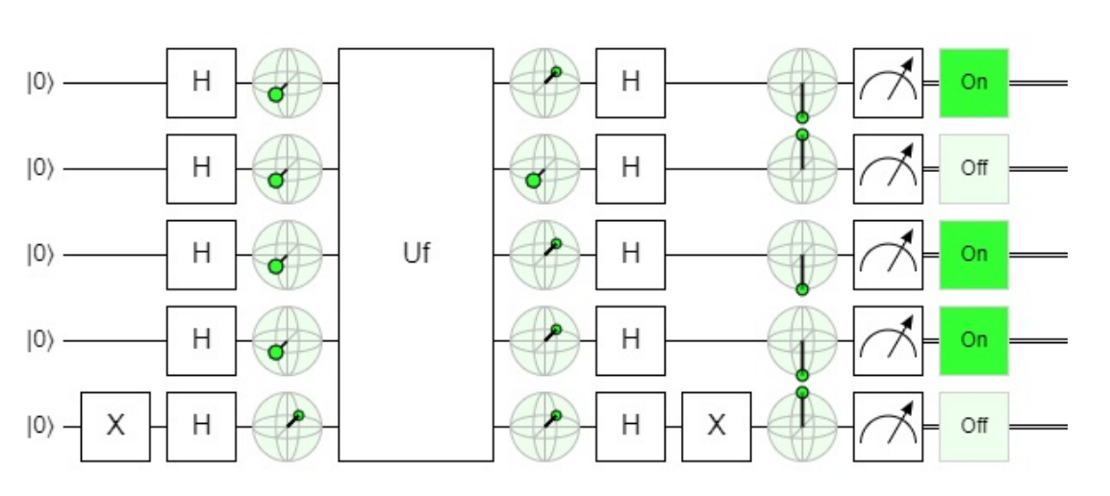
Figure shows a circuit diagram for the Bernstein-Vazirani algorithm (BV) on 5 qubits, one of which is used as an ancilla or accessory qubit. An example of an oracle circuit Uf encoding the integer value 13 (bit string ‘1101’) is shown in Figure. Each ‘1’ bit is encoded using a controlled NOT gate on the 5th ancilla qubit.

Slide 97
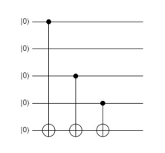
Figure: An example of the circuit that implements the Bernstein Vazirani Oracle function Uf. This example encodes the integer 13.
The main circuit of the Deutsch-Jozsa algorithm (DJ) is identical to the Bernstein-Vazirani algorithm, but it uses a slightly more complex oracle that encodes either a ‘constant’ or ‘balanced’ function. The oracle is very similar to the BernsteinVazirani—it also uses a sequence of CNOT gates—so it is not shown here.

Slide 98
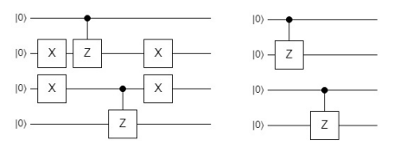
The Hidden Shift algorithm (HS) applies two oracle functions in a row, which contrasts with the DJ and BV algorithms. The first application of the oracle is identical to the second application, except that it includes a hidden ‘shift’—a secret integer that encodes a difference between the values returned from the two oracles (shown in Figure). The two oracles together result in a circuit depth for the HS that is nearly double that of the BV and DJ algorithms. Due to the similarities between these algorithms, we group them together as the ‘tutorial’ category.
Figure: Examples of circuits that implement the oracle functions for the Hidden Shift algorithm: Uf (left) and Ug (right).

Slide 99
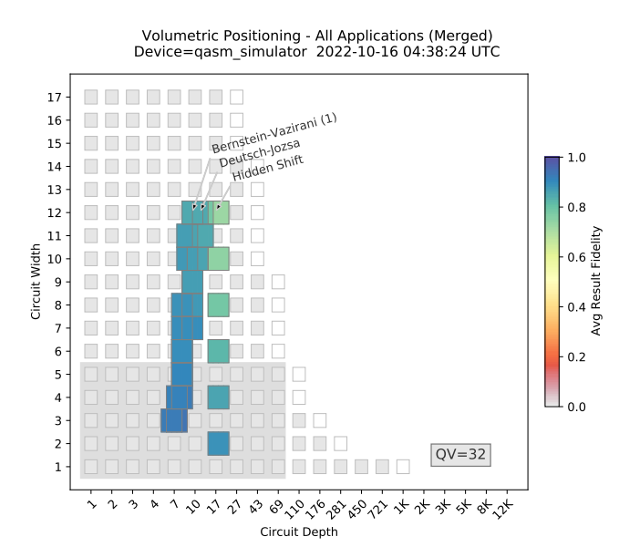
To construct benchmarks out of each of these algorithms, each circuit of a specific width is executed multiple times with a random integer encoded in the oracle. Figure shows the results obtained from executing these 3 benchmarks on the noisy simulator, for between 2 and 12 qubits.
It's a common practice to run benchmarks on simulators before moving to actual quantum hardware, especially in the presence of noise. This helps assess the algorithm's performance and understand its behavior under realistic conditions.
Figure: Results from running the three oracle algorithm benchmarks on a simulator.

Slide 100
2. Quantum Fourier Transform
Two benchmarks, QFT(1) and QFT(2), based on the Quantum Fourier Transform (QFT) are used to assess the performance of quantum computers in implementing the QFT and its inverse, with potential applications in quantum algorithms such as Shor's algorithm.
QFT(1) Benchmark:
Initialization: N qubits are initialized to encode a random integer x (e.g., x = 13).
QFT Circuit: Utilizes Hadamard gates and controlled Z rotations to encode the input integer value into the Fourier basis.
Rotation Gates: Simple rotation gates are applied to add 1 modulo $2^{n}$ in the Fourier basis to the input state. (Note: This addition of 1 modulo $2^{n}$ introduces a specific phase shift to the state, effectively incrementing the encoded integer by 1)
Inverse QFT Circuit: Implements the standard circuit for the inverse QFT, converting the Fourier basis state back into the computational basis.
Measurement: All qubits are measured, resulting in a bit string representing x+1 mod $2^{n}$ .

Slide 101
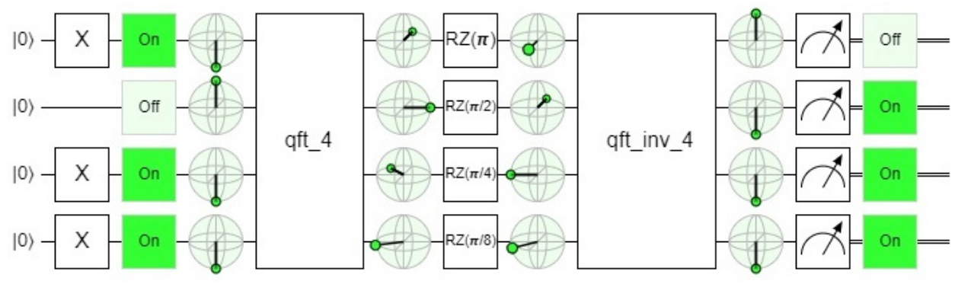
Figure: An example of the circuits used in the QFT(1) benchmark
This benchmark acts as a form of Loschmidt echo or a mirror circuit, where the QFT is undone by the subsequent inverse QFT.
The inclusion of the +1 operation prevents easy compilation down to an identity and adds sensitivity to errors. A randomly selected operation may be included in the future for better error sensitivity.
Note: The Loschmidt echo is a concept from quantum physics that measures the sensitivity of a quantum system to perturbations or disturbances. In the QFT(1) benchmark, the Loschmidt echo is analogously described as a type of mirror circuit. The standard Quantum Fourier Transform (QFT) circuit is followed by its inverse, effectively undoing the transformation.

Slide 102
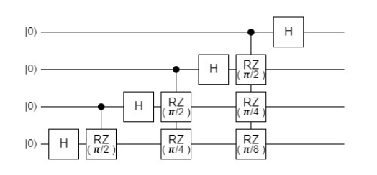
Figure: The standard circuit that implements the n = 4 qubit QFT.
The inverse QFT sub-circuit is a mirror image of the QFT circuit (with gates replaced with their inverses, meaning that the rotation angles are negated and the Hadamard gates are unchanged).
The QFT implementation does not use SWAP gates, effectively reversing the order of the qubits.

Slide 103
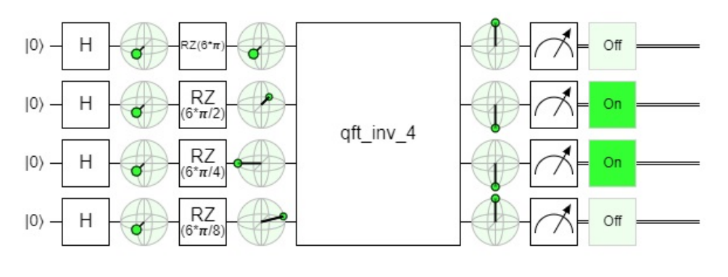
QFT(2) Benchmark:
Inverse QFT Circuit Only: Executes only the standard circuit for the inverse QFT.
Fourier Basis State Preparation: The inverse QFT operates on a quantum state prepared in a Fourier basis state.
Figure: Demonstrates the circuit for encoding the integer value 6 in the Fourier basis for the QFT(2) benchmark.

Slide 104
State Preparation Method: Uses a set of one-qubit gates (Hadamard gates and Z rotations) to encode a specific integer value x in the Fourier basis.
Measurement: If there are no errors, the measurement result should be the bit string encoding x.
Circuit Depth: The circuits of the QFT(2) benchmark are similar to the second half of circuits of the QFT(1) benchmark, so the circuit depth in QFT(2) is approximately half that in QFT(1) for fixed n.
A noteworthy consequence is that QFT(1) and QFT(2) benchmarks can be used for cross-validation (to validate and corroborate the results obtained from each other). If both benchmarks effectively quantify a quantum computer's performance on the QFT and its inverse, and if errors in the QFT and its inverse are comparable, then the result fidelity obtained from QFT(1) is expected to be approximately the square of the result fidelity from QFT(2).

Slide 105
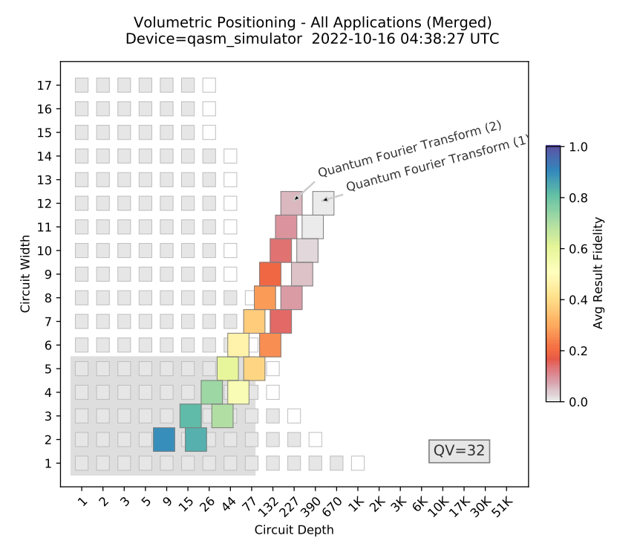
Figure: Shows the results obtained from executing the QFT(1) and QFT(2) benchmarks on a simulator, indicating an expected relationship between their fidelities.

Slide 106
3. Grover’s Search Algorithm
Grover’s algorithm, also referred to as the quantum search algorithm, is one of the most well known quantum algorithms due to its quadratic run-time speedup over the best known classical algorithm.
Grover's algorithm aims to find the correct item from an unordered list.
It achieves a quantum speedup by starting in a uniform superposition and using repeated calls to a quantum oracle to amplify the probability of measuring the correct state.
The amplification technique used in Grover's algorithm was generalized into amplitude amplification, which is employed in other quantum algorithms like Amplitude Estimation and Monte Carlo algorithms.

Slide 107
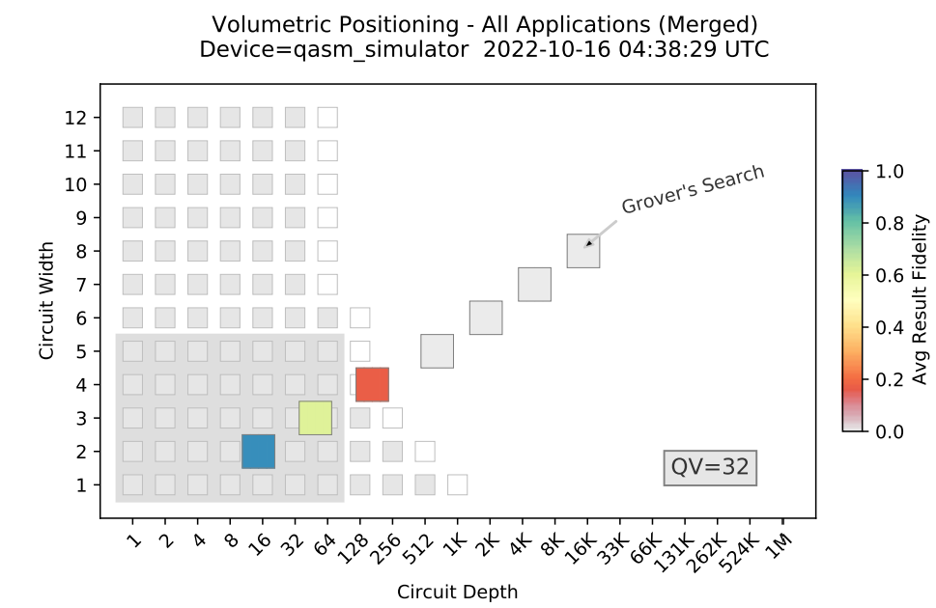
Figure: Results from running the Grover’s Search Benchmark on a simulator.

Slide 108
Grover's Search Benchmark:
Oracle Marking:
The benchmark is designed so that the oracle marks a given bit string with a phase of -1.
Circuit Construction:
Multiple circuits are constructed at each circuit width by generating random bit strings of a length equal to the width of the circuit.
Circuit Width and Depth:
A volumetric plot illustrates the rapid increase in circuit depth with increasing circuit width.
The increase in circuit depth leads to a rapid drop in result fidelity as the circuit width grows.
Note:
Grover's algorithm for n qubits uses many n-qubit Toffoli gates.
Toffoli gates need to be decomposed into one- and two-qubit primitive gates, significantly increasing the circuit depth.
Shallower decompositions of n-qubit Toffoli gates are possible using ancilla qubits, but this is not implemented in the described benchmark.

Slide 109
4. Phase and Amplitude Estimation
Quantum Phase Estimation (QPE) Benchmark:
Estimate the eigenvalues of a unitary operator by calculating the corresponding phases.
Unitary Selection:
The benchmark selects a phase gate with eigenvalues exp(±iθ), where θ is defined with a precision of 2^(-k), and k is the number of qubits in the register storing the measured phase.
Random Theta Selection:
Random values for θ are chosen of the form n /2^k, where k represents the total number of measured qubits, and n is an integer between 0 and 2^k - 1.
Precision Definition:
Precision of θ is determined by the number of qubits in the register.

Slide 110
Amplitude Estimation (AE) Benchmark:
Subroutines:
Contains two quantum subroutines: quantum circuits implementing quantum amplitude amplification and quantum phase estimation.
Quantum Amplitude Amplification:
Encodes the amplitudes of a target quantum state into a phase, which can be extracted using phase estimation.
Precision in Amplitude Estimation:
Performs the simplest case of quantum amplitude estimation where amplitudes are specified to a precision that can be exactly encoded in the available qubits.

Slide 111
Results and Comparison:
Circuit Depth:
The depth of the Phase Estimation benchmark's circuits scales similarly to the depth of circuits in the QFT-based benchmarks, as the QFT is the subroutine of phase estimation that uses the deepest circuits.
Amplitude Estimation Circuit Depth:
The Amplitude Estimation benchmark involves deeper circuits due to the quantum amplitude amplification protocol.
Quantum Volume of 32:
The figure shows that a quantum computer with a quantum volume of 32 is incapable of high-fidelity implementations of the Amplitude Estimation algorithm, at least when implemented in its standard form, even for tiny problem instances.

Slide 112
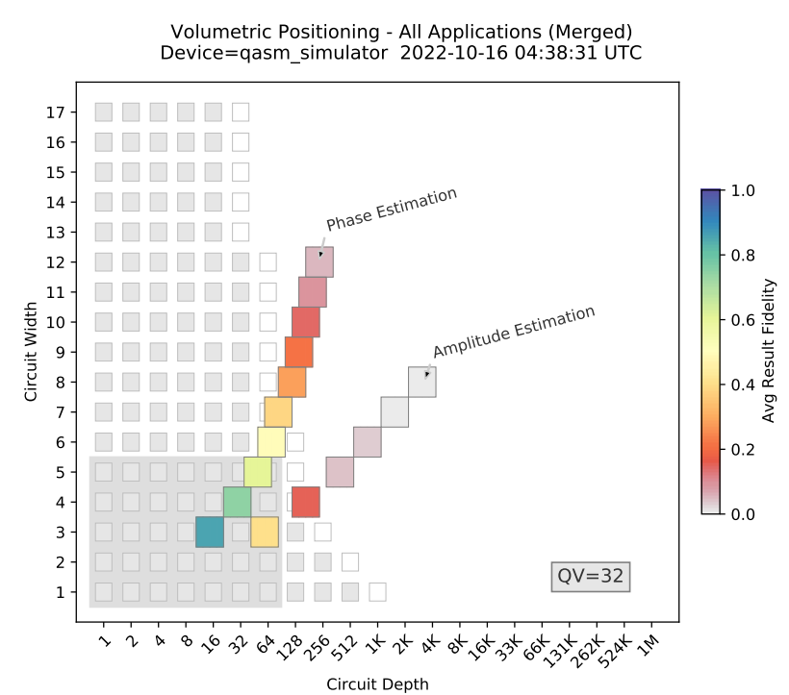
Figure: Shows the results obtained when executing the Phase Estimation and Amplitude Estimation benchmarks

Slide 113
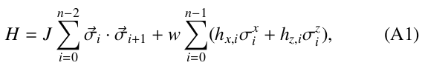
5. Hamiltonian Simulation
The chosen Hamiltonian is for the anti-ferromagnetic Heisenberg chain of 1-D spins with disordered x- and z-fields and open boundary conditions.
The Hamiltonian is described by the equation:
where J and w are the strength of the interactions and the disordered fields respectively, hx,i and hz,i give the strength of the X and Z disordered fields at site i, n is the total number of qubits, and σ^{{x,y,z}} are the usual Pauli operators.
In this benchmark, J = 1, w = 10, and hx,i and hz,i are randomly generated in the range (−1, 1).
The algorithm initializes the qubits in a product state and evolves them according to a Trotterized version of the Hamiltonian.
The Trotterization implements the term exactly using a construction from Vatan and Williams. We use a fixed number of Trotter steps.

Slide 114
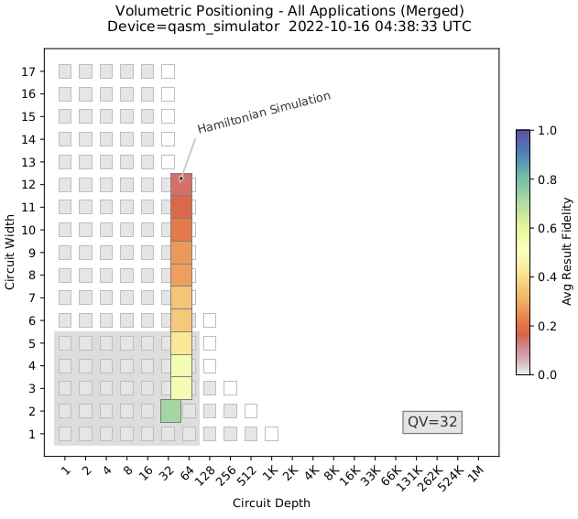
Figure: Results from running the Hamiltonian Simulation benchmark on a simulator.

Slide 115
Many-Body Localization:
constructing a Hamiltonian simulation benchmark without exponentially expensive classical computations could involve using many-body localization.
Many-body localization is a phenomenon where evolution under a random Hamiltonian preserves certain quantities.
However, long evolution times are required for many-body localization, resulting in circuits containing thousands of circuit layers.
Acknowledges that such a benchmark might not be practical for current hardware.
Many-body localization offers a promising avenue for constructing Hamiltonian simulation benchmarks without exponentially expensive classical computations, the practical challenges, especially the requirement for extensive circuit layers, may limit its feasibility on current quantum hardware.

Slide 116


6. Monte Carlo Sampling
Classical Monte Carlo algorithms use random processes to solve problems numerically where other methods might be infeasible.
A quantum algorithm which has a quadratic speed up over classical Monte Carlo algorithms was proposed by Woerner and Egger, which we have used here as the basis for our Monte Carlo Sampling benchmark.
The Monte Carlo sampling algorithm aims to compute the expected value of some function f(X), where X is a random variable that p(X) distributed.
Utilizes two oracles, R and F.
R encodes the probability distribution p(X) into the amplitudes of n qubit states.
F encodes the function value f(i) into the amplitude of a single auxiliary qubit.

Slide 117

Figure:
Results from running the two benchmarks based on the Monte Carlo Sampling algorithm on a simulator.
Provides insights into the performance of the algorithm for different choices of f and p.

Slide 118


Equation (A4): Describes the resultant state after applying F and R on an n+1 qubit system.
Recall that for the amplitude estimation, given the operator A,
the amplitude estimation algorithm yields a. The Monte Carlo Sampling algorithm works by applying
and then perform amplitude estimation on the resultant state to produce
which is the expectation value of the f function.
Equation (A6): Defines the operator A as FR for the amplitude estimation algorithm.

Slide 119
Benchmark Variations:
Monte Carlo Sampling(1): General version where users can choose arbitrary f and p, resulting in deep circuits.
Monte Carlo Sampling(2): Fixed p to the uniform distribution and f to the parity function, resulting in circuits with specific gate compositions.

Slide 120
7. Variational Quantum Eigensolver
Solving the electronic structure problem is one of the most promising applications for quantum computers, with potential contributions to drug discovery, developing new materials and catalysts for more efficient light-harvesting and CO2 reduction, understanding high-temperature super conductivity, and other important use cases.
VQE is a promising approach in the Noisy Intermediate-Scale Quantum (NISQ) era.
The VQE algorithm implements a parameterized circuit for a chosen wavefunction ansatz. It then measures the energy expectation value of the wave function and optimizes the circuit parameters towards a direction that lowers the energy expectation value.
Note:
NISQ refers to the current phase of quantum computing where devices are not yet fully fault-tolerant but are large enough to surpass the capabilities of classical computers in certain tasks.
VQE is a quantum algorithm designed for near-term quantum computers, making it well-suited for NISQ devices.
A wavefunction ansatz is a candidate wavefunction that is proposed as an initial guess or form in quantum mechanics, particularly in the context of variational methods. The term "ansatz" is of German origin and means "assumption" or "approach."

Slide 121




The VQE algorithm is based on the variational principle,
in which the energy expectation value of an parameterized wave function Ψ(~θ) is lower bounded by the exact ground state energy E0 .
Herein, H is the electronic Hamiltonian defined as
in which $h_{pq}$, $g_{pqrs}$ are the one- and two-electron integrals, and a, a† are the Fermionic annihilation and creation operators.
An important aspect of the VQE algorithm is the choice of the wave function ansatz. Many choices exist, and for our VQE-based benchmark we choose to use the unitary Coupled Cluster with singles and doubles ansatz (unitary-CCSD). This ansatz is defined by
where T is the cluster operator and |Φi is the reference state, which is chosen to be the Hartree-Fock (HF) state.

Slide 122

The cluster operator is defined by
in which i, j indicate molecular orbitals that are occupied in the HF state, and a, b indicate molecular orbitals that are empty in the HF state. tªj and t^{ab}ij are the wave function parameters associated with single and double excitations.
The unitary CCSD ansatz is a variant of the widely used traditional CCSD ansatz. Unlike the traditional CCSD ansatz, which fails to model strongly correlated systems, the unitary CCSD ansatz has been shown to produce highly accurate results in both weakly and strongly correlated systems.
However, there is no known classical method that can evaluate the energy expectation value of the unitary CCSD ansatz with polynomial cost. In contrast, its unitary nature means that it is natural to implement on a quantum computer.

Slide 123




Both the electronic Hamiltonian and the unitary CCSD ansatz are defined with Fermionic operators. In order to implement them on a quantum computer, one needs to first transform them to Pauli operators. VQE benchmarks use the Jordan-Wigner transformation :
where I, X, Y and Z are Pauli matrices and N is the total number of qubits. Upon the Jordan-Wigner transformation, both the Hamiltonian and the cluster operator becomes a weighted sum of Pauli words
where $P^{i}$ is a tensor product of Pauli matrices,

Slide 124

Figure: Results from running VQE(1), one of our two VQE-based
benchmarks, on a simulator.

Slide 125
The VQE algorithm proceeds by iteratively evaluating and optimizing the energy by varying the wave function parameters, until the minimum is found.
The full VQE algorithm includes both a quantum and a classical part. The former is used to implement the ansatz and measure the energy, and the latter is applied to optimize the ansatz parameters.
Our initial VQE-based benchmark, VQE(1), only implements the quantum part of the algorithm. For VQE(1), we randomly sample the wave function parameters and choose a fixed measurement basis (varying the measurement basis is generally necessary to measure the expectation value of the Hamiltonian H(T)).
In our benchmarks, the Hamiltonian and the wave function is implemented for the NaH molecule with a bond length of 1.9 Angstrom with the STO-6G basis. By changing the number of orbitals to simulate, we vary the number of qubits.
The smallest case is n = 4 qubits, which corresponds to 2 electrons and 4 spin orbitals. Figure (in previous slide) shows the results of executing VQE(1) on a quantum simulator up to 10 qubits.

Slide 126
8. Shor’s Order Finding
Shor’s factoring algorithm is one of the most well-known applications of quantum computing. Shor’s factoring algorithm includes both a quantum and classical subroutine.
The quantum subroutine finds the smallest integer period, or the order, of a periodic function while the classical subroutine uses this order to determine the factors of a number in polynomial time.
This process may need to be repeated multiple times, in case an invalid order is generated. Since the order finding routine is the bottleneck of integer factorization, our focus is on benchmarking the quantum subroutine of order finding.
The algorithm is designed for finding the order of functions that take the form f (x) = a x mod N where a < N. The order r of this function is the r satisfying ar mod N = 1. If r is known, a classical computer can compute the prime factors of N in polynomial time.
Our benchmarks based on Shor’s order finding algorithm generate random values of r and N from which a corresponding base value a can be analytically calculated. The quantum algorithm for order finding is actually a variation of quantum phase estimation where the chosen unitary operator performs modular exponentiation. This modular exponentiation encodes the order in the phases of a quantum state.

Slide 127

We constructed two benchmarks based on Shor’s order finding algorithm, Shor’s Order Finding(1) and Shor’s Order Finding(2), based on variants of Shor’s algorithm introduced by Stephane Beauregard. Shor’s Order Finding(1) is based on the standard formulation of Shor’s algorithm, and it requires 4n + 2 qubits where n is the problem instance size (meaning that N is an n bit integer). Shor’s Order Finding(2) uses a version of Shor’s algorithm that utilizes mid-circuit measurements to reduce the number of qubits. This method uses 2n + 3 qubits. Figure shows the results obtained executing both these benchmarks on a simulator.
Figure: Shor’s Order Finding Algorithms

Slide 128
Appendix B
(Limitations of the Average Result Fidelity)

Slide 129
There are some limitations in using average result fidelity to Quantify performance. Consider, example which illustrates the limitations of both fidelity and averaging of fidelity over multiple circuits.
Consider an algorithm of Flipping a single qubit from the |0⟩ state to the |1⟩ state using a Hadamard gate operation.

Slide 130


Example of any two Quantum Computers A & B:
Quantum Computer A accurately performs the Hadamard gate operation, flipping the qubit from |0⟩ to |1⟩ and Successfully achieves the intended result.
Fidelity Calculation $F_{s}$($P_{output}$, $P_{ideal}$) for A approaches 1, indicating a high fidelity between the intended $P_{ideal}$ (qubit in |1⟩) and the output $P_{output}$ (qubit in |1⟩).
So, A consistently achieves the desired result, resulting in high fidelity between the expected and actual outcomes.
Quantum Computer B: due to hardware noise or imperfections, Quantum Computer B occasionally fails to execute the Hadamard gate perfectly. Despite attempts, it sometimes retains the qubit in the |0⟩ state instead of flipping it to |1⟩.
Fidelity Calculation $F_{s}$($P_{output}$, $P_{ideal}$) for B might fluctuate sometimes, it's close to 1 when the qubit successfully flips to |1⟩, and sometimes, it's considerably lower when the qubit remains in |0⟩ due to errors.
So, B shows fluctuations in fidelity due to intermittent failures in executing the Hadamard gate correctly.

Slide 131

So What’s the catch?
The fidelity metric ($F_{s}$ ) might misrepresent the performance of Quantum Computer B.
Even with varying fidelity scores, Quantum Computer B might still occasionally achieve the correct result despite the lower fidelity due to hardware limitations or noise.
This scenario demonstrates how relying solely on average result fidelity might not always accurately capture the performance of quantum computers, especially when intermittent errors or hardware imperfections lead to fluctuations in fidelity scores.
It raises the need for additional metrics or considerations beyond fidelity to comprehensively assess quantum computer performance.

Slide 132
Appendix C
(Issues with Different Quantum Computing APIs)

Slide 133
Quantum applications are implemented using different APIs, including Qiskit, Cirq, Braket, and Q#.
While these APIs share common features, achieving complete consistency across all of them is challenging due to certain constraints.
To address differences, the benchmark suite is primarily implemented using the Qiskit API, with some benchmarks also implemented using Cirq and Braket APIs.
Simulated executions on quantum simulators are consistently performed using the Qiskit implementation, leveraging its rich circuit analysis features.
Executions on quantum hardware also use the Qiskit version of the benchmarks, except for experiments on Rigetti Computing’s hardware, which use the Braket version.

Slide 134
Challenges arise in defining benchmark circuits in a high-level gate set and transpiling them to both a standard gate set and the native operations of a specific quantum computer.
The compilation algorithm's performance affects circuit depth, and its behavior may vary across APIs, making consistent depth comparisons challenging.
Limitations and Differences: API differences, such as the absence of direct support for certain gates in Braket, and other issues related to circuit compiling, topology information, and metrics availability, pose challenges.
Despite challenges, Qiskit is chosen as the primary platform due to its overall best set of features for implementing the benchmark suite and conducting the necessary analysis.
An API-independent definition of circuit depth is suggested to enable consistent result comparisons across different APIs.

Slide 135
Appendix D
(Advances in Quantum Computers)

Slide 136
Developing early benchmarks in a technology's development helps establish markers for measuring advances in hardware and software.
Anticipating technological advances in the next five years is crucial for designing benchmarks that remain relevant over multiple product cycles.
Incorporating factors like mid-circuit measurement, parameterized gate operations, and closer integration of classical and quantum computation into benchmarks enhances their adaptability.
Continuous community input and collaboration with quantum computing hardware providers allow the benchmark suite to evolve effectively.
The goal is to gauge the impact of performance improvements resulting from ongoing advances in quantum computing technology.

Slide 137
1. Mid-Circuit Measurements:
Originally, classical measurements of qubit states in early quantum computers were allowed only at the end of the circuit, and qubits were not reusable.
Recent advancements by companies like IBM and Quantinuum enable measurements at any stage of the quantum circuit, allowing qubits to be reset and reused during computation.
The measurements are recorded, qubits are reset to an initial state, and additional computation can be performed while qubit coherence is maintained by the quantum hardware. The measurements collected during execution may be retrieved by the user with an API call.
Benefits of Mid-Circuit Measurements:
Mid-circuit measurements facilitate constructing algorithms with a smaller number of qubits, improving efficiency.
An example involves implementing a Bernstein-Vazirani circuit on IBM hardware using only 2 qubits to encode a 12-bit secret string, resulting in higher fidelity compared to a larger 13-qubit circuit.

Slide 138

Figure: A quantum circuit on 2 qubits that uses mid-circuit measurements to efficiently implement the Bernstein-Vazirani algorithm. This circuit implements the same computation as the standard Bernstein-Vazirani circuit on 5 qubits. This is the basis for the Bernstein-Vazirani(2) benchmark.

Slide 139
Implementation in Benchmark Suite:
The benchmark suite incorporates initial benchmarks that test and leverage mid-circuit measurements.
These benchmarks focus on using fewer qubits while maintaining the same problem size (qubit-equivalent), demonstrating the advantages of mid-circuit measurements.
Examples from Benchmarks:
In the Bernstein-Vazirani(1) benchmark, a sweep (iteration) is performed over progressively larger numbers of qubits, encoding a larger secret integer each time.
The Bernstein-Vazirani(2) benchmark implements the same sweep over the problem input size but uses only two-qubit circuits, increasing the depth of the circuit instead of the width.
Shor’s Order Finding(2) benchmark implements Shor’s order finding algorithm using a single qubit quantum phase estimation circuit with mid-circuit measurement, resulting in a reduction in circuit width and improved fidelity of results.

Slide 140

2. Circuit Parameterization :
Certain quantum algorithms, such as the Variational Quantum Eigensolver (VQE) and Quantum Approximate Optimization Algorithm (QAOA), involve multiple iterations.
These iterations modify the quantum circuit before executing additional rounds of shots.
The VQE algorithm utilizes a parameterized ansatz circuit, where rotation angles (parameters) on the gates are adjusted before each execution.
Figure: An example of a parameterized quantum circuit, containing a single parameter (θ), from a small instance of the VQE algorithm using the UCC ansatz.

Slide 141
Challenges with Circuit Modification:
Modifying rotation angles can be time-consuming, involving the recreation of the circuit in a high-level language (e.g., Qiskit), compilation for the target backend, and reloading.
This preparation time becomes significant, especially for algorithms with hundreds or thousands of iterations.
Support for Parameter Definition in APIs:
Qiskit and Cirq programming APIs support parameter definition within circuits using Python sympy objects, aiming to enhance performance by reducing compilation.
Despite this support, circuit reloading is still required.
Potential for Future Advances:
Future advances in quantum computer control systems may reduce the latency between parameterized executions, making it negligible and optimizing execution time.

Slide 142
VQE-Based Benchmarks:
VQE-based benchmarks involve the execution of a parameterized circuit, where the ansatz circuit is executed repeatedly with different angles applied to its gates.
Currently, the benchmarking suite cannot fully leverage parameterized circuit representations and execution.
Future Work and Enhancements:
Future work could enhance benchmarks by incorporating methods to define the ansatz as a parameterized circuit, potentially reducing the time-consuming steps in circuit preparation for iterative algorithms like VQE.

Slide 143
3. Multiply-Controlled Gates:
Some benchmark circuits use multiply-controlled gate operations, where the operation on the target qubit is controlled by more than a single qubit.
The Toffoli gate, particularly the many-qubit Toffoli gate, is employed in defining several benchmarks.
Challenges in Hardware Implementation:
Current quantum hardware cannot implement multiply-controlled gates natively.
Transpilation is needed to break down these operations into smaller primitive gates for implementation on existing quantum devices.
Benchmark Challenges:
Some benchmarks use n-qubit Toffoli gates, where n is proportional to the circuit width.
The transpiled depth of an n-qubit Toffoli gate increases rapidly with n, causing transpiled circuits to grow in depth quickly as circuit width increases.

Slide 144

Figure: The standard decomposition of a standard Toffoli gate (a 3-qubit Toffoli gate) into smaller primitive gate operations, showcasing the complexity of transpilation.
Potential for Future Hardware Advances:
Hardware advances may lead to native implementations of some multiply-controlled gates, such as the Toffoli gate implemented as a CCZ gate described by Bækkegaard et al.
Performance Improvement through Native Implementation:
If multiply-controlled gates are implemented natively in future hardware, benchmarks relying on them will quantify the performance improvement achieved through such native implementations.

Slide 145
4. Close Classical/Quantum Integration
Focus on Total Execution Time:
Increasing attention is directed towards the total execution time of quantum applications, considering both quantum and classical computation stages.
Quantum Computer Advancements:
Quantum computers can now execute complex applications involving multiple iterations of quantum circuits, often interleaved with classical computation.
Architectural improvements in hardware and firmware can significantly reduce the total execution time of applications.
Reduction in Time to Solution:
IBM reports enhancements to their quantum computing architecture leading to a reduction in the 'time to solution' for specific problems from days to hours.
This emphasizes a focus on practical improvements in computing time rather than just asymptotic scaling comparisons with classical computing.

Slide 146
Evolutionary Reduction in Computing Time:
Current research into quantum accelerators and other architectural optimizations indicates a trend towards further reductions in execution times.
Hybrid Quantum-Classical Architectures:
Architectures like quantum-classical-cloud and IBM's Qiskit Runtime aim to tightly couple classical and quantum parts of hybrid algorithms for faster execution.
Integrating classical computations within the coherence time of qubits is explored for even tighter integration.
Need for Benchmark Suite Updates:
Benchmarking suites, including the mentioned one, may need updates to fully test and measure the performance of tightly integrated classical and quantum processing.

Slide 147
Measurement of Execution Times:
Precise measurement of execution times for various stages in combined quantum/classical applications is crucial for gauging the impact of integration.
The current benchmark suite reports quantum-specific execution times but may require updates to systematically report and compare execution times aggregated over multiple runs.

Slide 148


